Slide 1
Chapter 11
Chapter 11 Network Management Applications
Week 9
Network Management Applications
Chapter 11 in Subramanian, Gonsalves & Rani (2010) – All sections
do not consider slides from 18 to 29, so do not consider
  Rule-based reasoning
  Model-based reasoning
  Case-based reasoning

Slide 2
Objectives
Chapter 11 Network Management Applications
Network management and system management
Network management
      Configuration
      Fault
      Performance
      Security
      Accounting
Configuration management
  Configuration management
  Service/Network provisioning
  Inventory management
Fault management
  Fault detection and isolation
  Correlation techniques for root cause analysis
Performance management
  Performance metrics
  Data monitoring
  Problem isolation
  Performance statistics
Security management
  Security policies and procedures
  Security threats
  Firewall
  Cryptography: keys, algorithms, authentication, and authorization schemes
  Secure message transfer methods
Accounting management
Report management
Policy-based management
Service level management
  Quality of service, QoS
  Service level agreement, SLA

Slide 3
Chapter 11 Network Management Applications
Network and Systems Mgmt
The management of networked information services involves management of network and system resources. OSI defines network management as a five-layer architecture. We have extended the model to include system management and have presented the integrated architecture in Figure 11 1. At the highest level of TMN are the functions associated with managing the business, business management.
An institution is a business that provides either a product or service.
The third layer of TMN deals with network management or system management. Network management manages the global network by aggregating and correlating data obtained from the element management systems.
the system management aggregates and coordinates system resources by acquisition of data from the resource management systems.
The complementary functions of network and system management manage the networked information system composed of network elements and system resources.
Our focus in this chapter will be on network management applications. As we learned in Chapter 3, there are five different categories of applications: configuration management, fault management, performance management, security management, and account management.
five layers of management
1
2
3
4
5
  Notes
TMN architecture expanded to include systems
management

Slide 4
Chapter 11 Network Management Applications
Management Applications
The configuration management not only from an operational viewpoint, but also from engineering and planning viewpoints, we have included network provisioning and inventory management.
Fault management involves detection of a fault as it occurs in the network, and subsequently locating
the source of the problem. We should finally isolate the root cause of the problem.
We discuss performance management in Section 11.3. We will discuss performance metrics and learn how to monitor a network for performance. Performance statistics play a very important part in network management, and several system tools available for gathering statistics will be covered.
Security in network is concerned with preventing illegal access to information by unauthorized personnel. It involves not only technical issues, but also establishment of well-defined policies and procedures.
The business health of an institution or corporation depends on well-maintained accounting management and reporting.
Reports for management have a different purpose. There are reports needed for the user to measure the quality of
service to be provided by service level agreement (SLA).
We have addressed the five layers of management with
network elements being at the lowest level
and business management being at the top.
Element management at the second layer maintains the network.
Network management at the third level and
service management at the fourth level are based Not just on technical issues but also on policy issues.
OSI Model
  Configuration
  Performance
  Fault
  Security
  Accounting
Reports
Service Level Management
Policy-based management
  Notes

Slide 5
Chapter 11 Network Management Applications
Configuration Management
Network Provisioning
Inventory Management
  Equipment
  Facilities
Network Topology
Database Considerations
Configuration management in network management is normally used in the context of discovering network topology, mapping the network, and setting up the configuration parameters in management agents and management systems.
However, as discussed in Section 1.9 and shown in Figure 1.21, network management in the broad sense also includes network provisioning.
Network provisioning includes network planning and design and is considered part of configuration management.
  Notes

Slide 6
Chapter 11 Network Management Applications
Circuit Provisioning
Network provisioning, also called circuit provisioning in the telephone industry. The design of a trunk and a special service circuit is done by application programs written in operation systems.
Planning systems and inventory systems are integrated with design systems to build a system of systems. Thus, a circuit designed for the future automatically derives its turn-up date from the planning system and ensures that the components are available in the inventory system. the design system is made aware of the availability of components for future designs.
An example of a circuit provisioning system is a system of systems developed by Bell System (before it was split), called Trunk Integrated Record Keeping System (TIRKS).
TTRKS is used in automated circuit provisioning of trunks. A trunk is a logical circuit between two switching offices and it traverses over many facilities. TIRKS is an operations system in the context of Telecommunications Management Network (TMN) that we dealt with in Chapter 10.
Given the requirements of a trunk, such as transmission loss and noise, type of circuit, availability date, etc., as input to the system, the system automatically designs the components of the trunk. The designed circuit will identify transmission facilities between switching offices and equipment in intermediate and end offices. The equipment will be selected based on what would be available in the future when the circuit needs to be installed.
Network provisioning for packet-switched network is based on performance statistics and quality of service requirements.
Network provisioning in broadband wireless area network (WAN) communication using ATM technology is more complex. The switches are cell-based, in contrast to frame-based packet switching.
Each ATM switch has knowledge of the virtual path-virtual circuit (VP-VC) of each session connection only to the neighboring nodes and not end-to-end.
The architecture of end-to-end provisioning of ATM circuits could be either centralized or distributed, and is based on whether the circuit is a permanent virtual circuit (PVC) or a switched virtual circuit (SVC).
Network Provisioning
  Provisioning of network resources
    Design
    Installation and maintenance
  Circuit-switched network
  Packet-switched network, configuration for
    Protocol
    Performance
    QoS
  ATM networks
  Notes
Examples:
  TIRKS (Trunk Integrated Record Keeping
  System) for circuit-switched networks
  E1 in TIRKS for equipment management
  F1 in TIRKS for facilities management
Inventory Management
We have addressed the importance of inventory management in circuit provisioning.
We need to be aware of all the details associated with components.
TIRKS, which is a system of systems. Two of the systems that TIRKS uses are equipment inventory (El) and facilities inventory (Fl).
The El system has an inventory of all equipment identifying what is currently available and what will become available in the future with dates of availability. Similar information is maintained on facilities by the Fl system.

Slide 7
Chapter 11 Network Management Applications
Network Topology
Manual (uses the arp command )
Autodiscovery by NMS using
  Broadcast ping
  ARP table in devices
Mapping of network
  Layout
  Layering
Views
  Physical
  Logical
  Notes
Network management is based on knowledge of network topology. As a network grows, shrinks, or otherwise changes, the network topology needs to be updated automatically.
The discovery process for example, uses the arp command to discover any network component that responds with an IP address.
Autodiscovery can be done using the broadcast ping. The more efficient method is to look at the ARP cache in the local router. The ARP cache table is large and contains the addresses of all the recently communicated hosts and nodes.
A map, showing network topology, is presented by the autodiscovery procedure after the addresses of the network entities have been discovered.
The autodiscovery procedure becomes more complex in the virtual local area network (LAN) configuration.

Slide 8
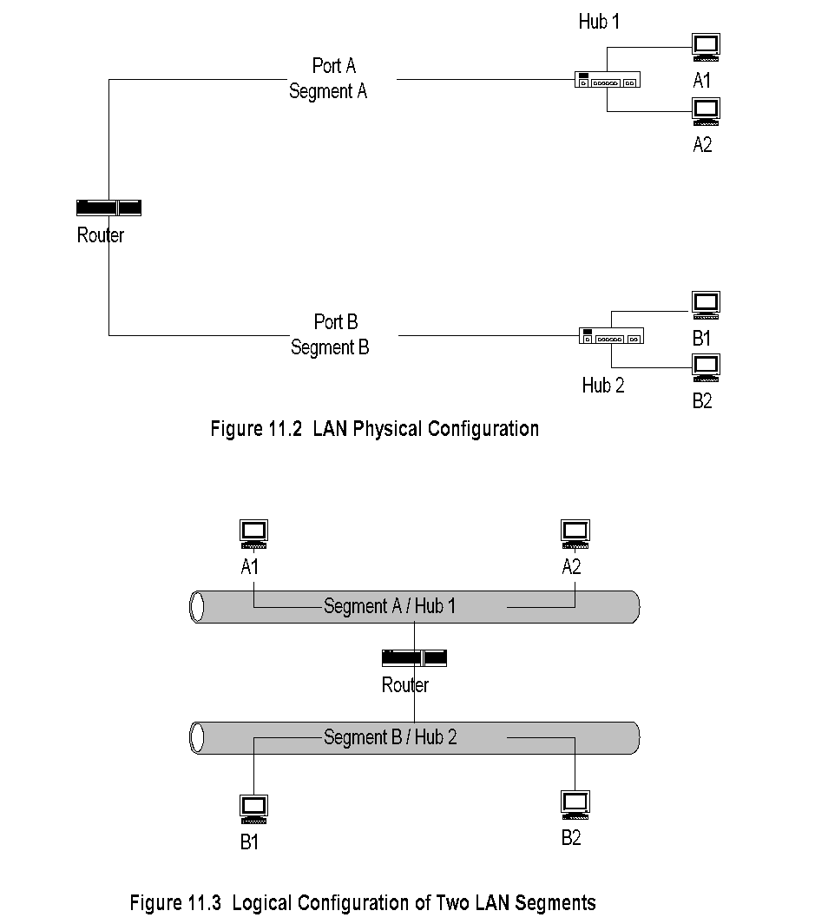
Chapter 11 Network Management Applications
Traditional LAN Configuration
Figure 11.2 shows the physical configuration of a conventional LAN. The router in the figure can be visualized as part of a backbone (not shown). There are two LAN segments connected to the router, Segment A and Segment B. They are physically connected to two physical ports in the router. They are identified as Port A and Port B, corresponding to Segment A and Segment B, respectively. Both LANs are Ethernet LANs and use hub configuration. Two hosts, A 1 and A2, are connected to Hub 1 on LAN segment A and two hosts, B1 and B2, are connected to Hub 2 on LAN Segment B.
Figure 1 1 .3 shows the logical configuration for Figure 1 1 .2. The logical configuration is what the autodiscovery process detects. It is very similar to the physical configuration.
Segment A corresponds to LAN on Hub 1 with the hosts A 1 and A2. It is easy to conceptually visualize this and easy to configure.
  Notes
One-to-one mapping between physical and logical configuration

Slide 9
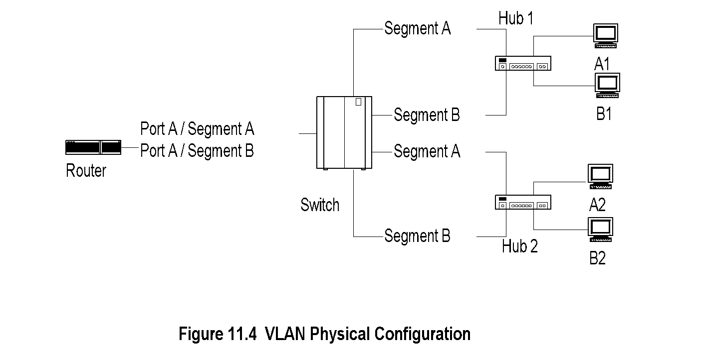
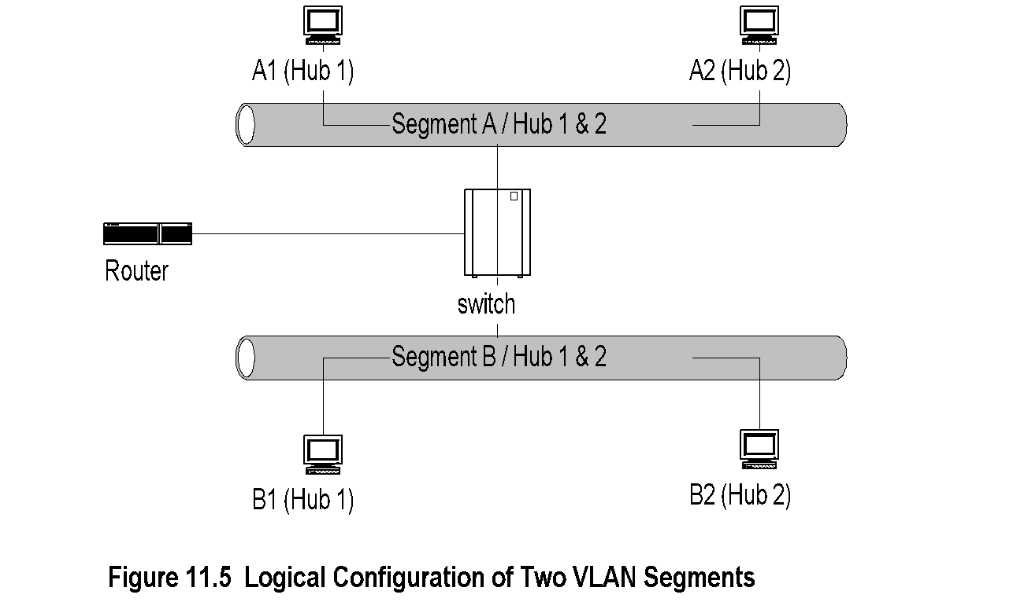
Chapter 11 Network Management Applications
Virtual LAN Configuration
Let us now contrast Figure 11.2 with Figure 1 1.4, which shows the physical configuration of two virtual LANs (VLAN). We notice that only one physical port, Port A, is used in the router, not two as in the case of a traditional LAN. Hosts A 1 and A2 are configured to be on VLAN 1, and hosts B1 and B2 are configured to be on VLAN 2. Although VLAN grouping can be done on different criteria, let us assume that it is done on port basis on the switch. Thus, the two ports marked Segment A on the switch are grouped as VLAN 1. The other two ports, marked Segment B, are grouped as VLAN 2. Thus, Segment A corresponds to VLAN 1 and Segment B corresponds to VLAN 2. We observe that VLAN 1 and VLAN 2 are spread across the two physical hubs, Hub 1 and Hub 2. With a layer-2 bridged network, the VLAN network is efficient. As IEEE 802.3 standards are established and widely adopted, this configuration has been deployed more and more, along with a backbone network.
The logical view of the physical VLAN configuration shown in Figure 11.4 is presented in Figure 11.5. We see that Hosts A 1 and A2 still belong to Segment A, but are on different hubs. Likewise, Hosts B1 and B2 belong to Segment B. The autodiscovery process would not detect the physical hubs that are identified in Figure 11.5. In many situations, the switch would also be transparent, as there are no IP addresses associated with switch ports. Consequently, it would be harder to associate the logical configuration with the physical configuration.
In the example above, we talked about grouping of VLAN based on the ports on the switches. We could also group VLAN based on MAC address, IP address, or protocol type. Grouping by IP address has some benefits in the management of VLAN network. The logical grouping of components based on IP network segments makes sense. In addition, as a policy the sysLocation entity in a system group should be filled in for easier management.
  Notes
Physical and logical configurations different
Physical location obtained from System group

Slide 10
Chapter 11 Network Management Applications
Fault Management
Fault location involves identifying where the problem is located. We distinguish this from problem isolation, although in practice it could be the same. The reason for doing this is that it is important to restore service to the users as quickly as possible, using alternative means. The restoration of service takes a higher priority over diagnosing the problem and fixing it. However, it may not always be possible to do this. Identification of the root cause of the problem could be a complex process, which we will go into greater depth soon. After identifying the source of the problem, a trouble ticket can be generated to resolve the problem. In an automated network operations center, the trouble ticket could be generated automatically by the NMS.
Fault is a failure of a network component
Results in loss of connectivity
Fault management involves a five-step process:
  Fault detection
    Polling
    Traps: linkDown, egpNeighborLoss
  Fault location
    Detect all components failed and trace
    down the tree topology to the source
    Fault isolation by network and SNMP tools
    Use artificial intelligence / correlation
    techniques
  Restoration of service
  Identification of root cause of the problem
  Problem resolution
Fault Detection
Fault detection is accomplished using either a polling scheme or by the generation of traps.
An application program in NMS generates the ping command periodically and waits for response.
The generic trap messages linkDown and egpNeighborLoss in SNMPvl can be set in the agents giving them the capability to report events to the NMS with the legitimate community name. One of the advantages of traps is that failure detection is accomplished faster with less traffic overhead.
Fault Location and Isolation Techniques
Fault location using a simple approach would be to detect all the network components that have failed. The origin of the problem could then be traced by walking down the topology tree where the problem starts.
After having located where the fault is, the next step is to isolate the fault

Slide 11
Chapter 11 Network Management Applications
Performance Management
Tools
Performance Metrics
Data Monitoring
Problem Isolation
Performance Statistics
we used the protocol analyzer as a system tool to measure traffic monitoring on Ethernet
LANs, which is in the realm of performance management.
traffic statistics collected over a period of from hours to a year using the Multi Router Traffic Grapher (MRTG) tool in Section 9.2.4. The statistics obtained using a protocol analyzer as a remote monitoring (RMON) tool was detailed in the case study in Section 8.6. We noticed how we were able to obtain the overall trend in Internet-related traffic and the type of traffic.
The purpose of the network is to carry information and thus performance management is really (data) traffic management. It involves the following: data monitoring, problem isolation, performance tuning, analysis of statistical data for recognizing trends, and resource planning.
  Notes
Tools:
  Protocol analyzers
  RMON
  MRTG

Slide 12
Chapter 11 Network Management Applications
Performance Metrics
Macro-level
    Throughput
    Response time
    Availability
    Reliability
Micro-level
    Bandwidth
    Utilization
    Error rate
    Peak load
    Average load
  Notes
Performance Metrics
The parameters that can be attributed to defining network performance on a global level are throughput, response time, network availability, and network reliability. The metrics on these are dependent on what, when, and where the measurements are made. Real-time traffic performance metrics are latency (i.e., delay) and jitter, which are addressed in Section 11.3.4.
These macro-level parameters can be defined in terms of micro-level parameters. Some of the parameters that impact network throughput are bandwidth or capacity of the transmission media, its utilization, error rate of the channel, peak load, and average load of the traffic. These can be measured at specific points in the network.

Slide 13
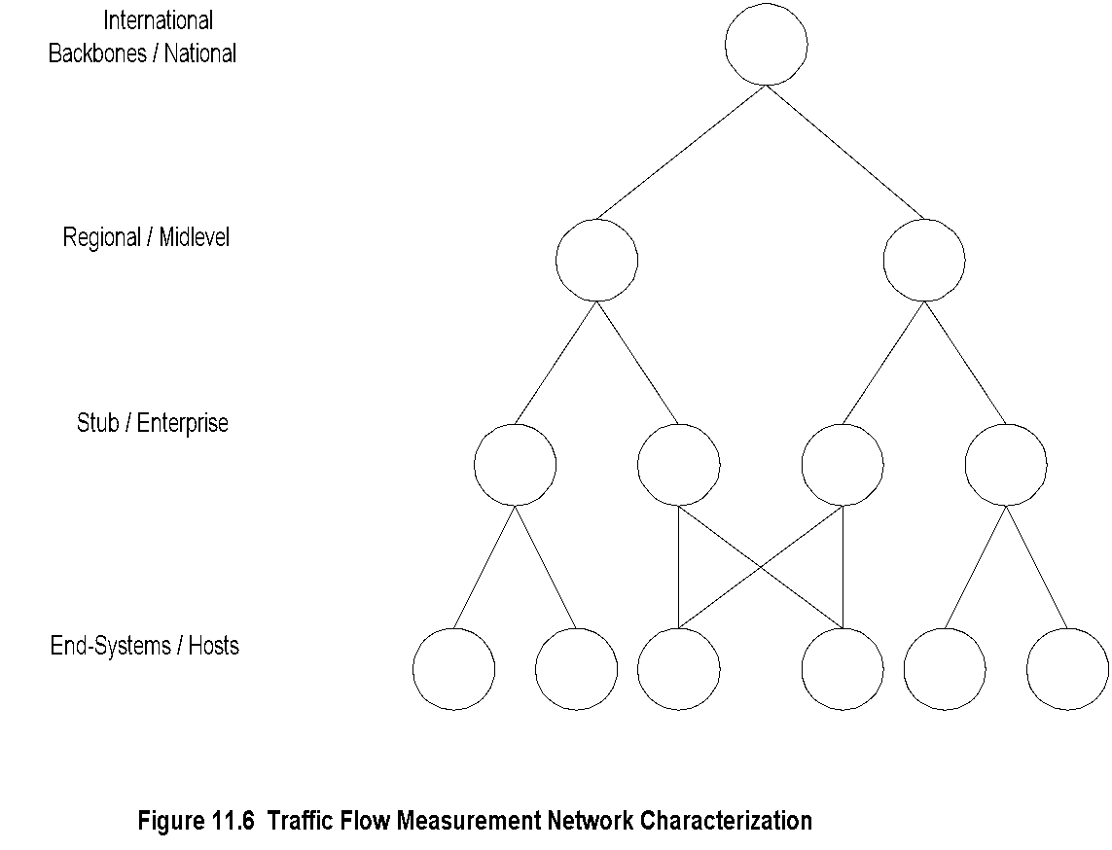
Chapter 11 Network Management Applications
Traffic Flow Measurement
Network Characterization
IETF Network Working Group has developed several Request for Comments (RFCs) on traffic flow measurement. RFC 2063 defines the architecture for the measurement and reporting of network traffic flows. The network is characterized as traffic passing through four representative levels, as shown in Figure 11 .6. Backbone networks are those that are typically connected to other networks, and do not have individual hosts connected to them. A regional network is similar to a backbone, but smaller. It may have individual hosts connected to it. Regional hosts are subscribers to a backbone network. Stub/enterprise networks connect hosts and LANs and are subscribers to regional and backbone networks. End systems or hosts are subscribers to all of the above.
The architecture defines three entities for traffic flow measurements: meters, meter readers, and managers.
Meters observe network traffic flows and build up a table of flow data records for them.
Meter readers collect traffic flow data from meters.
Managers oversee the operation of meters and meter readers.
  Notes
Four levels defined by IETF (RFC 2063)
Three measurement entities:
  Meters gather data and build tables
  Meter readers collect data from meters
  Managers oversee the operation
Meter MIB (RFC 2064)
NetrMet - an implementation (RFC 2123)

Slide 14
Chapter 11 Network Management Applications
Data Monitoring and
Problem Isolation
Data monitoring in the network for abnormal performance behavior, such as high collision rate in Ethernet LAN, excessive packet drop due to overload, etc., are detected by traps generated by agents and RMON. Performance-related issues are detected primarily using trap messages generated by RMON probes.
Problem isolation for performance-related issues depends on the type of problem. As we have indicated before, a high percentage of packet loss will cause loss of connectivity, which could be intermittent. In this situation, monitoring the packet loss over an extended period will isolate the problem.
Data monitoring
  Normal behavior
  Abnormal behavior
  Set up traps
  Set up alarms for criticality
  Manual and automatic clearing of alarms
Problem isolation
  Manual mode using network and SNMP tools
  Problems in multiple components need tracking down the topology
  Automated mode using correlation technology
  Notes

Slide 15
Chapter 11 Network Management Applications
Performance Statistics
Performance statistics are used in tuning a network.
Data are gathered by means of an RMON probe and RMON MIB for statistics. Statistics, to be accurate, require large amounts of data sampling, which create overhead traffic on the network and thus impact its performance. One of the enormous benefits of using RMON probe for collecting statistics is that it can be done locally without degrading the overall performance of the network. An RMON MIB contains the history and statistics groups (see Section 8.4) for various media and can be used efficiently to collect the relevant data and store them for current or future analysis.
Various error statistics at different layers are gathered to measure the quality of service and to do performance improvement, if needed. Some of the other performance parameters that can be tuned by monitoring network statistics are bandwidth of links, utilization of links, and controlling peak- to-average ratio of inherently bursty data traffic.
An important performance criterion in real-time traffic in broadband service is the latency or delay caused by dispersion in large bandwidth signal. This affects the quality of service due to performance degradation.
Another important statistic, especially in real-time broadband services, is the variation in network delay, otherwise known as jitter. This impacts the quality of service (QoS) guaranteed to the customer by the SLA
Traffic statistics
Error statistics
Used in
  QoS tracking
  Performance tuning
  Validation of SLA
  Trend analysis
  Facility planning
  Functional accounting
  Notes

Slide 16
Chapter 11 Network Management Applications
Event Correlation Techniques
We have illustrated some simple methods to diagnose and isolate the source of a problem in fault and performance management. When a centralized NMS receives a trap or a notification, it is called receiving an event.
A single problem source may cause multiple symptoms, and each symptom detected is reported as an independent event to the management system. Obviously, we do not want to treat each event independently and act to resolve it. Thus, it is important that the management system correlates all these events and isolates the root cause of the problem. The techniques used for accomplishing this are called event correlation techniques.
There are several correlation techniques used to isolate and localize fault in networks. All are based on (1) detecting and filtering of events, (2) correlating observed events to isolate and localize the fault either topologically or functionally, and (3) identifying the cause of the problem. In all three cases, there is intelligence or reasoning behind the methods. The reasoning methods distinguish one technique from another.
We will discuss six approaches to correlation techniques. They are (1) rule-based reasoning, (2) model-based reasoning, (3) case-based reasoning, (4) codebook, (5) state transition graph model, and (6) finite state machine model. See Lewis [1999] for a detailed comparison of the various methods.
Basic elements
  Detection and filtering of events
  Correlation of observed events using AI
  Localize the source of the problem
  Identify the cause of the problem
Techniques
  Rule-based reasoning
  Model-based reasoning
  Case-based reasoning
  Codebook correlation model
  State transition graph model
  Finite state machine model
  Notes

Slide 17
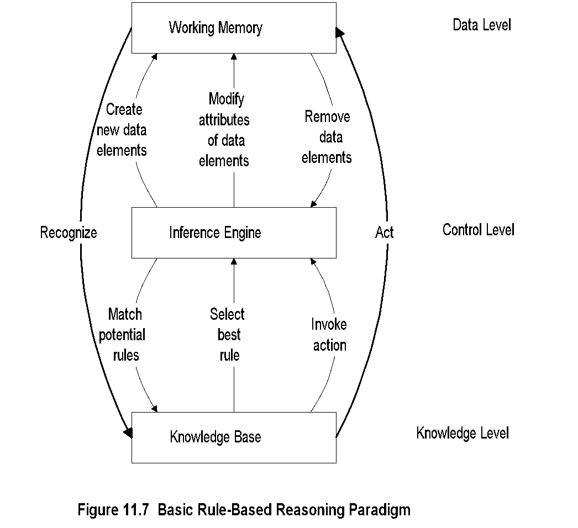
Chapter 11 Network Management Applications
Rule-Based Reasoning
  Notes
Knowledge base contains expert knowledge on
problem symptoms and actions to be taken
if -> then
condition -> action
Working memory contains topological and state
information of the network; recognizes system going into
faulty state
Inference engine in cooperation with knowledge base
decides on the action to be taken
Knowledge Base executes the action
Process is interactive
Network Management: Principles and Practice
© Mani Subramanian 2010
*

Slide 18
Chapter 11 Network Management Applications
Rule-Based Reasoning
Rule-based paradigm is an iterative process
RBR is “brittle” if no precedence exists
An exponential growth in knowledge base poses
problem in scalability
Problem with instability
if packet loss < 10% alarm green
if packet loss => 10% < 15% alarm yellow
if packet loss => 15% alarm red
Solution using fuzzy logic
  Notes
Network Management: Principles and Practice
© Mani Subramanian 2010
*

Slide 19
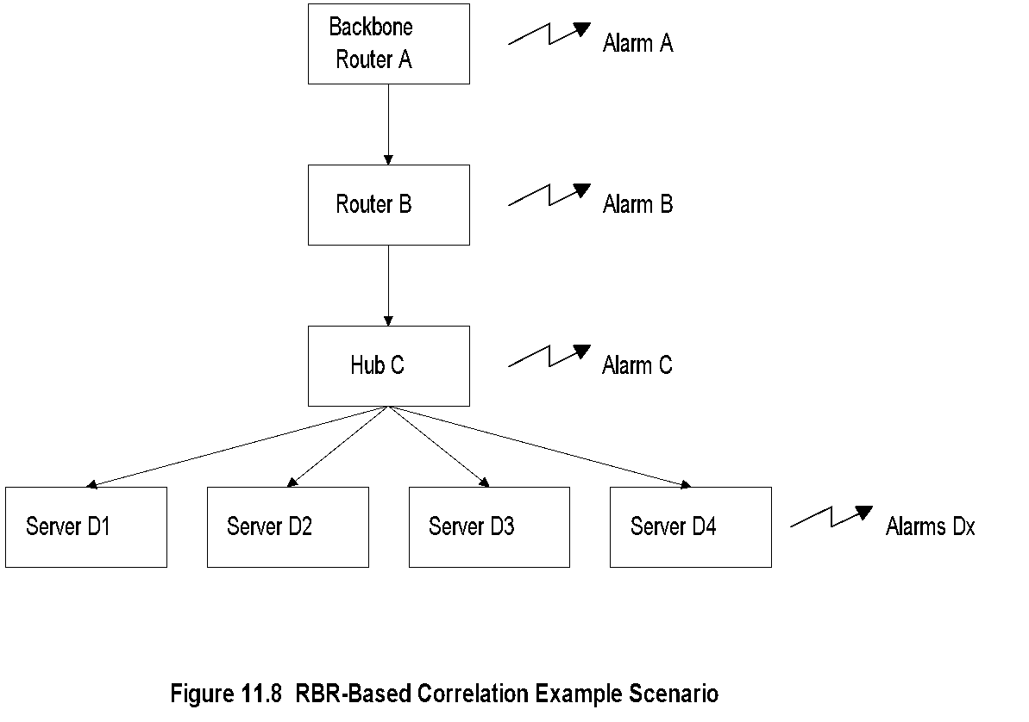
Chapter 11 Network Management Applications
Configuration for RBR Example
  Notes
Network Management: Principles and Practice
© Mani Subramanian 2010
*

Slide 20
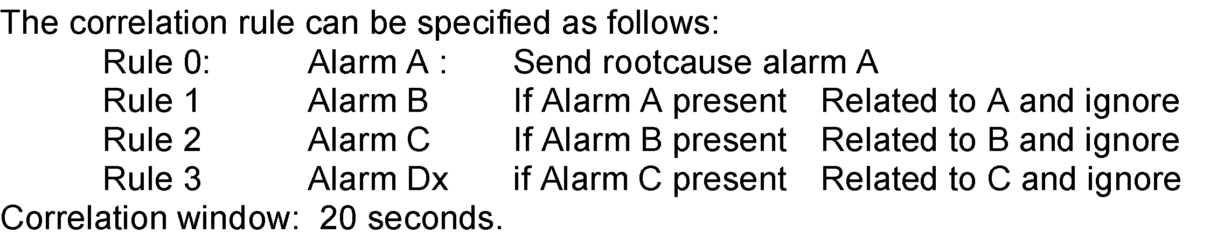
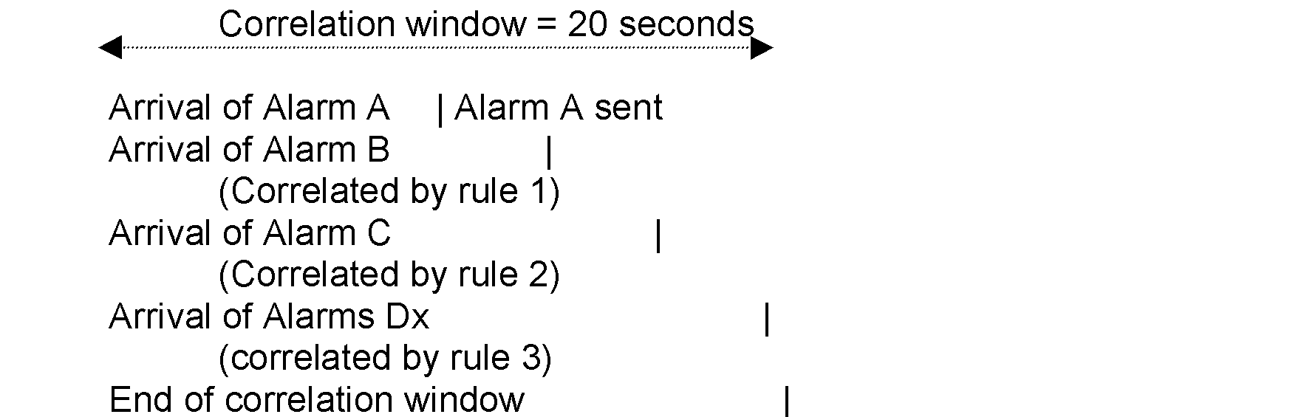
Chapter 11 Network Management Applications
RBR Example
  Notes
Network Management: Principles and Practice
© Mani Subramanian 2010
*

Slide 21
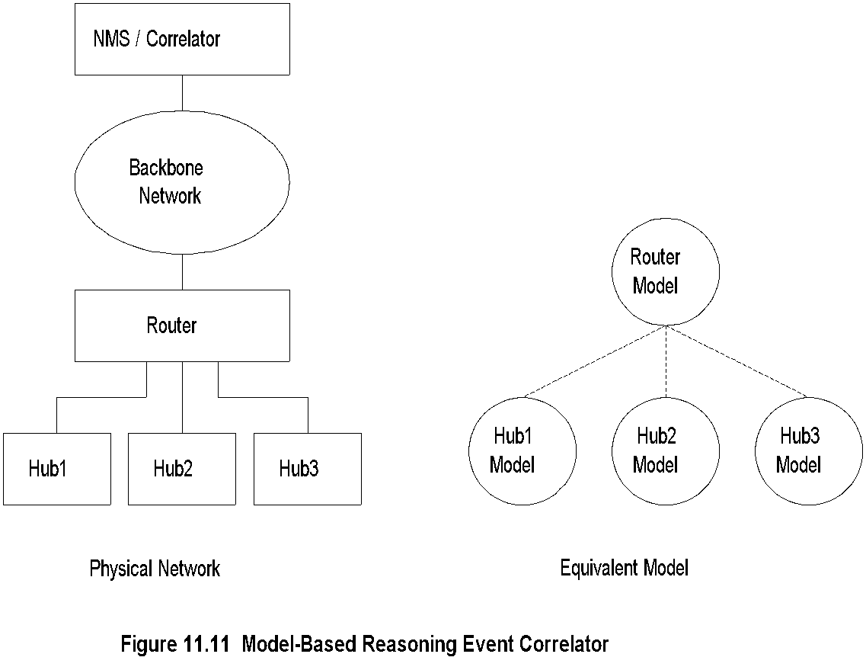
Chapter 11 Network Management Applications
Model-Based Reasoning
  Notes
Object-oriented model
Model is a representation of the component it models
Model has attributes and relations to other models
Relationship between objects reflected in a similar
relationship between models
Network Management: Principles and Practice
© Mani Subramanian 2010
*

Slide 22
Chapter 11 Network Management Applications
MBR Event Correlator
Example:
Hub 1 fails
Recognized by Hub 1 model
Hub 1 model queries router model
Router model
declares failure
Router model
declares no
failure
Hub 1 model
declares NO failure
Hub 1 model
declares Failure
  Notes
Network Management: Principles and Practice
© Mani Subramanian 2010
*

Slide 23
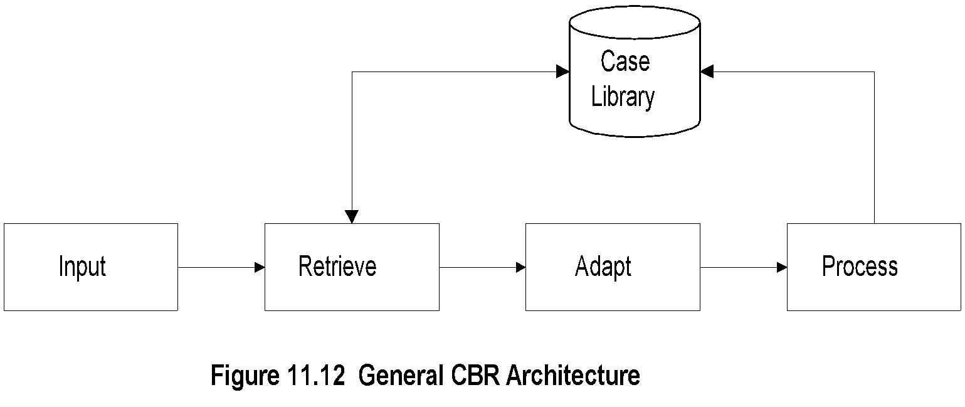
Chapter 11 Network Management Applications
Case-Based Reasoning
  Notes
Unit of knowledge
  RBR rule
  CBR case
CBR based on the case experienced before;
extend to the current situation by adaptation
Three adaptation schemes
  Parameterized adaptation
  Abstraction / respecialization adaptation
  Critic-based adaptation
Network Management: Principles and Practice
© Mani Subramanian 2010
*

Slide 24
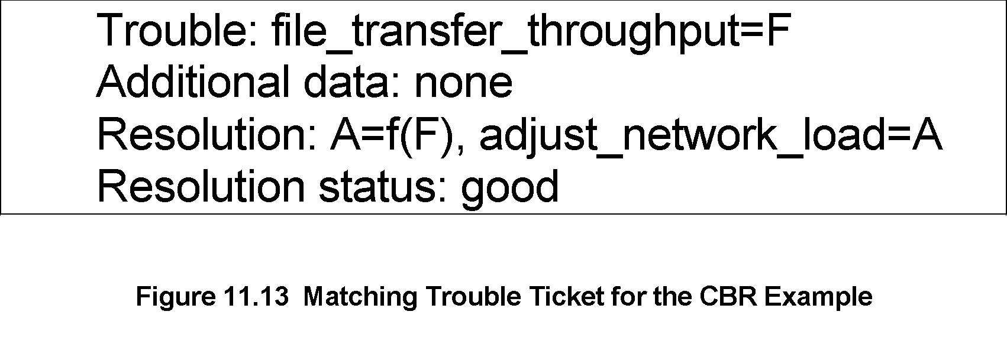
Chapter 11 Network Management Applications
CBR: Matching Trouble Ticket
Example: File transfer throughput problem
  Notes
Trouble ticket in case library: A = f(F)
Parameter A is a function of Parameter F
Network Management: Principles and Practice
© Mani Subramanian 2010
*

Slide 25
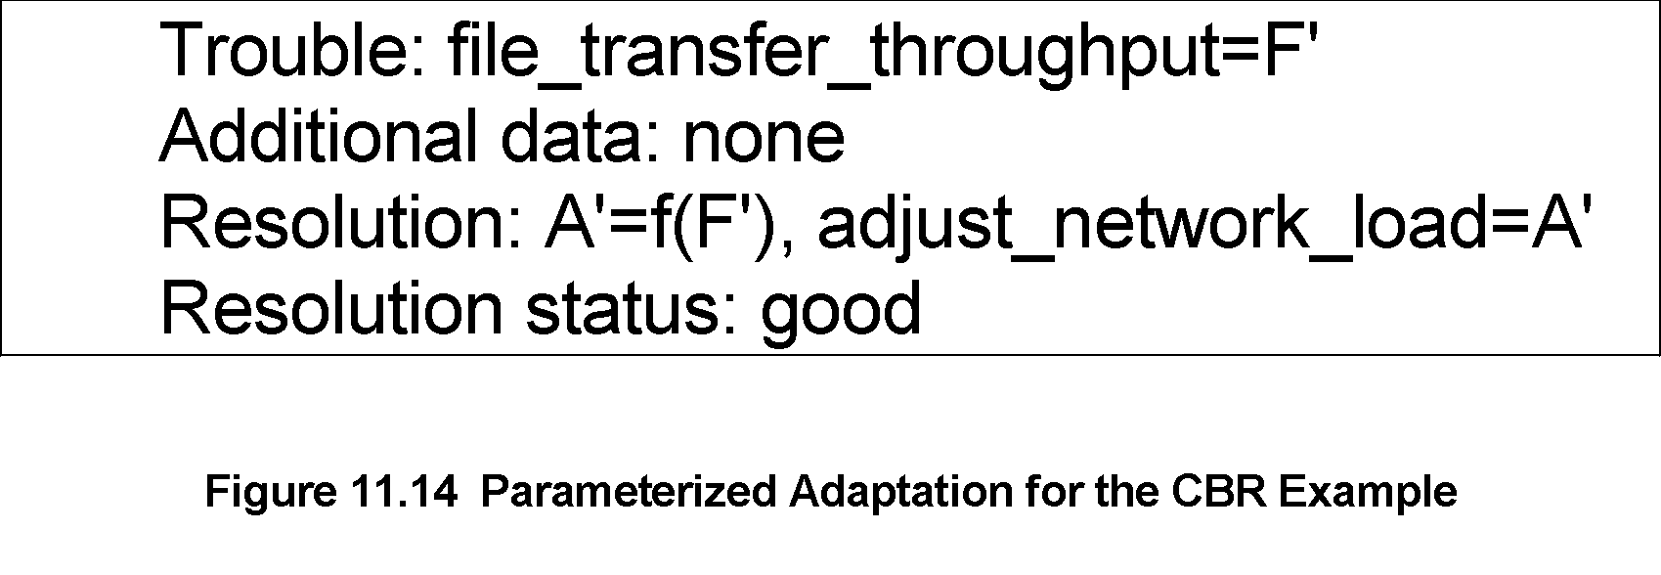
Chapter 11 Network Management Applications
CBR: Parameterized Adaptation
  Notes
A = f(F)
A’ = f(F’)
Functional relationship f(x) remains the same
Network Management: Principles and Practice
© Mani Subramanian 2010
*

Slide 26
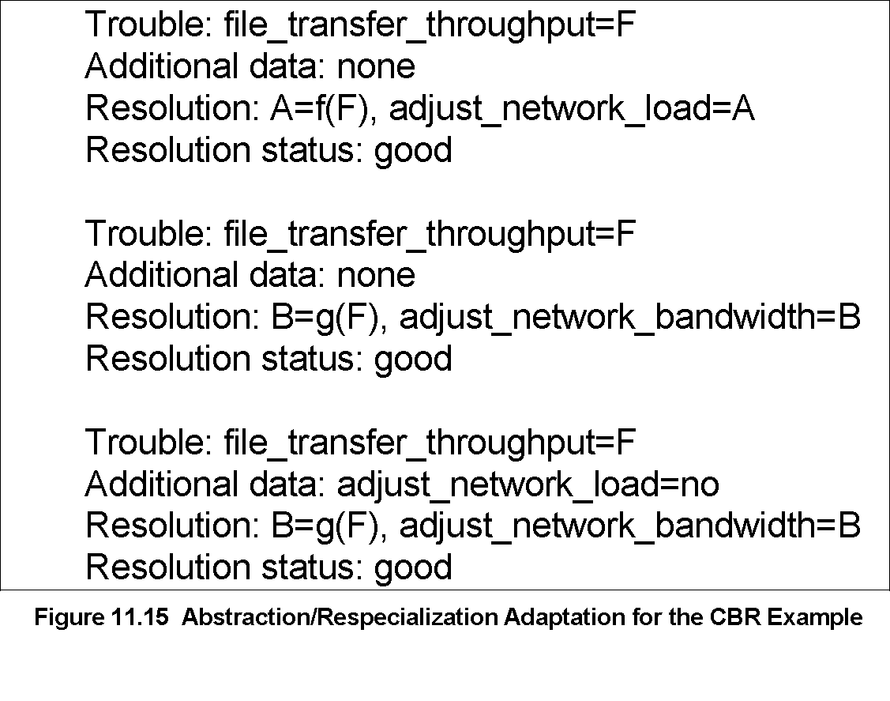
Chapter 11 Network Management Applications
CBR: Abstraction / Respecialization
  Notes
Two possible resolutions
  A = f(F) Adjust network load level
  B = g(F) Adjust bandwidth
Resolution based on constraint imposed
Network Management: Principles and Practice
© Mani Subramanian 2010
*

Slide 27
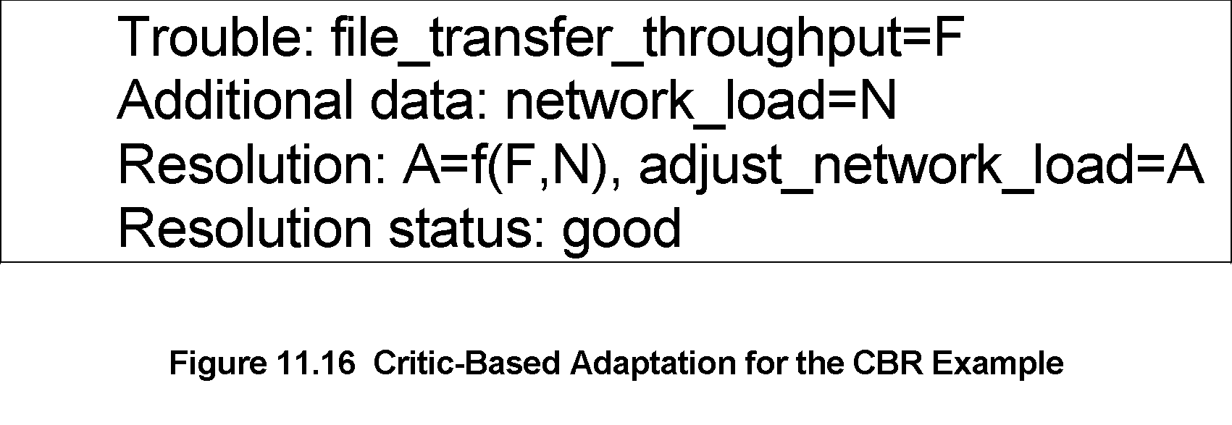
Chapter 11 Network Management Applications
CBR: Critic-Based Adaptation
  Notes
Human expertise introduces a new case
N (network load) is an additional parameter
added to the functional relationship
Network Management: Principles and Practice
© Mani Subramanian 2010
*

Slide 28
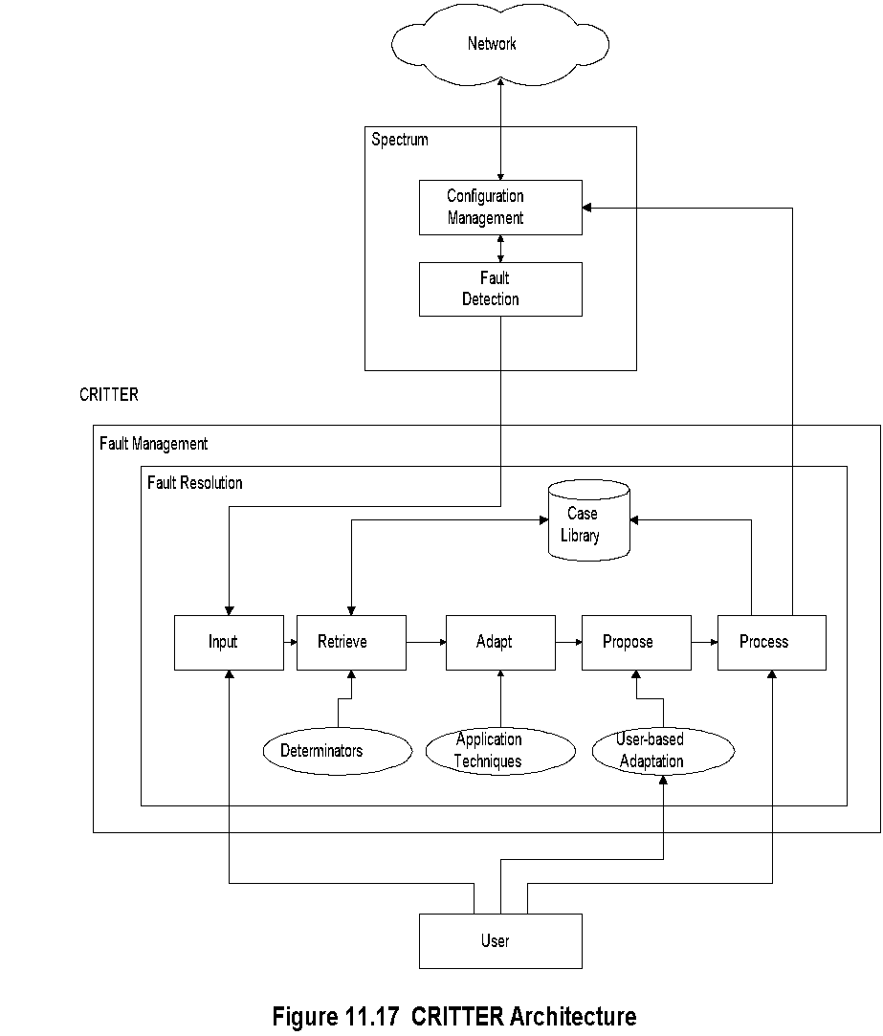
Chapter 11 Network Management Applications
CBR-Based Critter
  Notes
CRITTER is CBR-based trouble resolution system
Integrated with Cabletron Spectrum NMS
“Propose” is additional (5th) module to CBR
architecture; permits manual intervention
Network Management: Principles and Practice
© Mani Subramanian 2010
*

Slide 29
Chapter 11 Network Management Applications
Codebook Correlation Model:
Generic Architecture
Algorithms have been developed to correlate events that are generated in networks based on modeling
of the network and the behavior of network components.
Figure 11.18 shows the architecture of a model-based event correlation system, we will refer to this as codebook correlation.
Monitors capture alarm events and input them to the correlator.
The configuration model contains the configuration of the network.
The event model represents the various events and their causal relationships (we will soon define the causality relationship).
The correlator correlates the alarm events with the event model and determines the common problems that caused the alarm event.
  Notes
Yemini, et. al. proposed this model
Monitors capture alarm events
Configuration model contains the configuration of the network
Event model represents events and their causal relationships
Correlator correlates alarm events with event model
and determines the problem that caused the events
correlates يربط

Slide 30
Chapter 11 Network Management Applications
Codebook Approach
Approach:
Correlation algorithms based upon coding approach to even correlation
Problem events viewed as messages generated by a system and encoded in sets of alarms
Correlator decodes the problem messages to identify the problems
Two phases:
Codebook selection phase: Problems to be monitored identified and the symptoms they generate are associated with the problem. This generates codebook (problem-symptom matrix)
Correlator compares alarm events with codebook and identifies the problem.
  Notes
One of the correlation algorithms based on generic modeling is a coding approach to event correlation, In this approach, problem events are viewed as messages generated by a system and "encoded" in sets of alarms that they cause. The function of the correlator is to "decode“ those problem messages to identify the problems. Thus, the coding technique comprises two phases.
In the first phase, called the codebook selection phase, problems to be monitored are identified and the symptoms or alarms that each of them generates are associated with the problem. This produces a problem-symptom matrix.
In the second phase, the correlator compares the stream of alarm events with the codebook and identifies the problem.

Slide 31
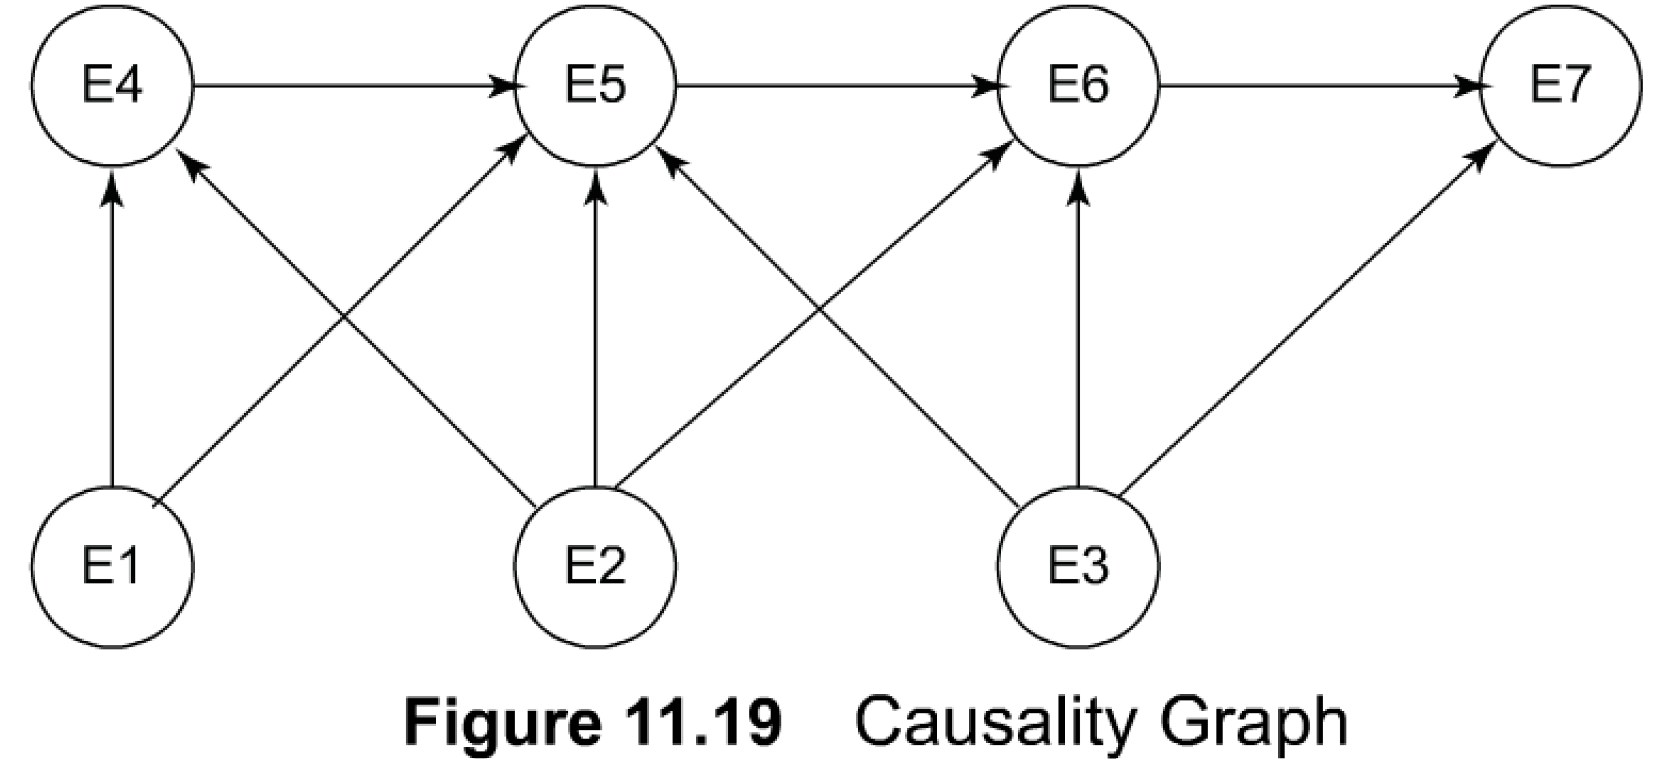
Chapter 11 Network Management Applications
Causality Graph
In order to generate the codebook matrix of problem-symptom, let us first consider a causality graph, which represents symptom events caused by other events.
An example of such a causality graph is shown in Figure 11.19.
Each node in the graph represents an event.
Nodes are connected by directed edges, with edges starting at a causing event and terminating at a resulting event.
For example, event El causes events E4 and E5. Notice that events El,E2,and E3 have the directed edges only going out from them and none coming into them.
We can identify these nodes as problem nodes and the rest as symptom nodes, as they all have at least one directed edge pointing in ward.
With problems labeled as Ps and symptoms as Ss, the newly labeled causality graph of Figure 11.19 is shown in Figure 1 1.20.
El,E2,and E3 are problem nodes
Others are symptom nodes
  Notes
Each node is an event
An event may cause other events
Directed edges start at a causing event and
terminate at a resulting event
Picture causing events as problems and
resulting events as symptoms

Slide 32
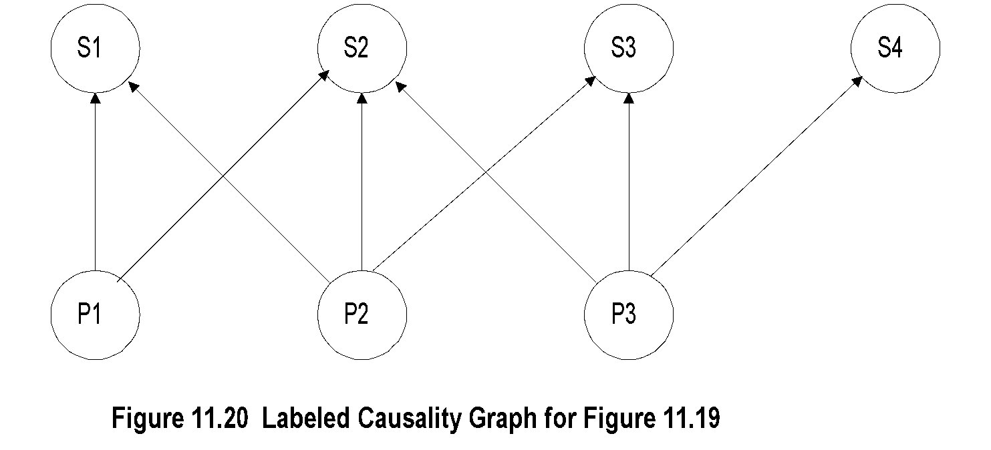
Chapter 11 Network Management Applications
Labeled Causality Graph
With problems labeled as Ps and symptoms as Ss, the newly labeled causality graph of Figure 11.19 is shown in Figure 1 1.20.
There are three problem nodes, PI, P2, and P3, and four symptom nodes SI, S2, S3, and S4.
We have eliminated those directed arrows where one symptom causes another symptom, as it does not add any additional information to the overall causality graph.
eliminated those directed arrows where one symptom causes another symptom
  Notes
Ps are problems and Ss are symptoms
P1 causes S1 and S2
Note directed edge from S1 to S2 removed;
S2 is caused directly or indirectly (via S1) by P1
S2 could also be caused by either P2 or P3

Slide 33

Chapter 11 Network Management Applications
Codebook
We can now generate a codebook of problem-symptom matrix for the causality graph of Figure 1 1.20 (we will drop the qualifier "labeled" from now on).
This is shown in Figure 11.21 with three columns as problems and four rows as symptoms.
In general, the number of symptoms will exceed the number of problems and hence, the codebook can be reduced to a minimal set of symptoms needed to uniquely identify the problems. It is easy to show that two rows are adequate to uniquely identify the three problems in the codebook shown in Figure 11.21. We will keep row SI and try to eliminate subsequent rows, one at a time. At each step, we want to make sure that the remaining codebook distinguishes between the problems. You can prove to yourself that eliminating rows S2 and S3 does not preserve the uniqueness, whereas eliminating either S2 and S4 does.
Figure 11.21 Codebook for Figure 11.20
  Notes
Codebook is problem-symptom matrix
It is derived from causality graph after removing
directed edges of propagation of symptoms
Number of symptoms => number of problems
2 rows are adequate to uniquely identify 3 problems

Slide 34
The reduced codebook, called the correlation matrix, is shown in Figure 1 1.22.
Drawing the causality graph based on the correlation matrix of Figure 11.20, we derive the correlation graph shown in Figure 11.23, which is called the correlation graph.
We will apply the above knowledge to a more general situation of the causality graph shown in Figure 11.24.
Figure 11.24(a) depicts the causality graph of 11 events.
Figure 11.24(b) shows the equivalent problem-symptom causality graph. Nodes 1,2, and 1 1 show only outgoing directed arrows and are hence identified as problems and the rest of the nodes as symptoms.
We will now reduce the causality graph to a correlation graph. Symptoms 3, 4, and5 form a cycle of causal equivalence and can be replaced by a single symptom, 3. Symptoms 7 and 10 are caused, respectively, by

Slide 35

Chapter 11 Network Management Applications
Correlation Matrix
The reduced codebook, called the correlation matrix, is shown in Figure 1 1.22.
Drawing the causality graph based on the correlation matrix of Figure 11.20, we derive the correlation graph shown in Figure 11.23, which is called the correlation graph.
Figure 11.22 Correlation Matrix for Figure 11.20
  Notes
Correlation matrix is reduced codebook

Slide 36
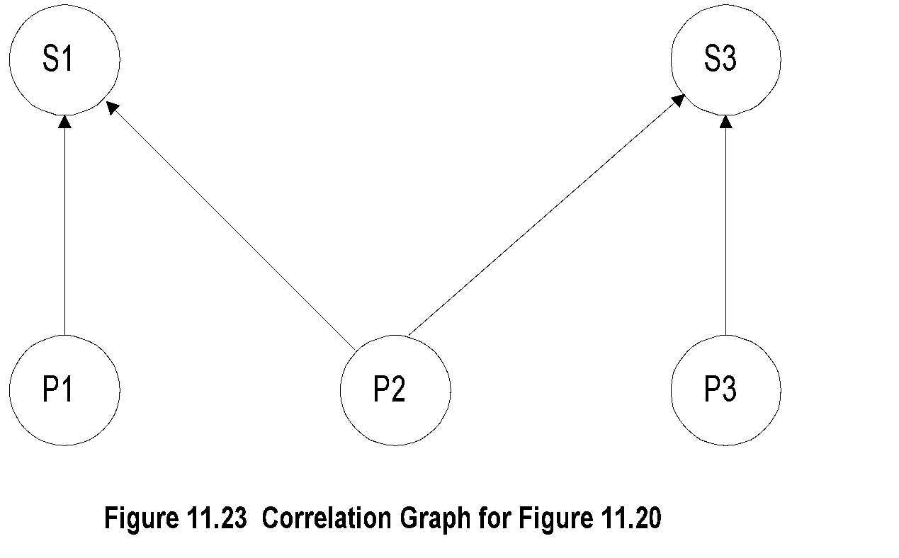
Chapter 11 Network Management Applications
Correlation Graph
we derive the correlation graph shown in Figure 11.23, which is called the correlation graph.
We will apply the above knowledge to a more general situation of the causality graph shown in Figure 11.24.
  Notes
Correlation graph is derived from correlation matrix
Network Management: Principles and Practice
© Mani Subramanian 2010
*

Slide 37
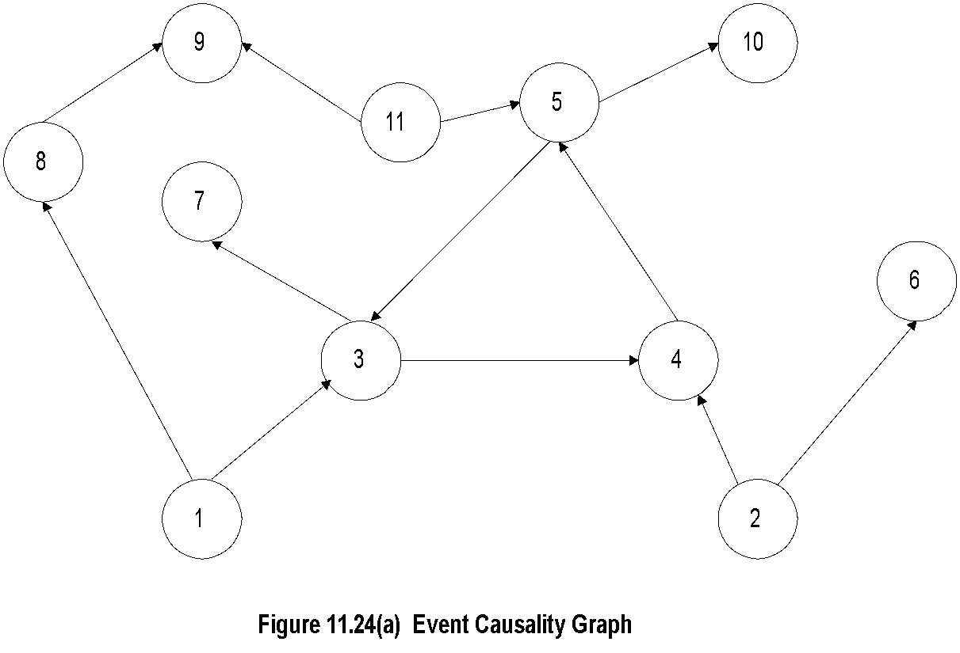
Chapter 11 Network Management Applications
Generalized Causality Graph
Figure 11.24(a) depicts the causality graph of 11 events.
Nodes 1,2, and 11 show only outgoing directed arrows and are hence identified as problems and the rest of the nodes as symptoms.
  Notes
Causality graph has 11 events - problems and symptoms
Mark all nodes that have only emerging directed
edges as problems - Nodes 1, 2, and 11
Other nodes are symptoms

Slide 38
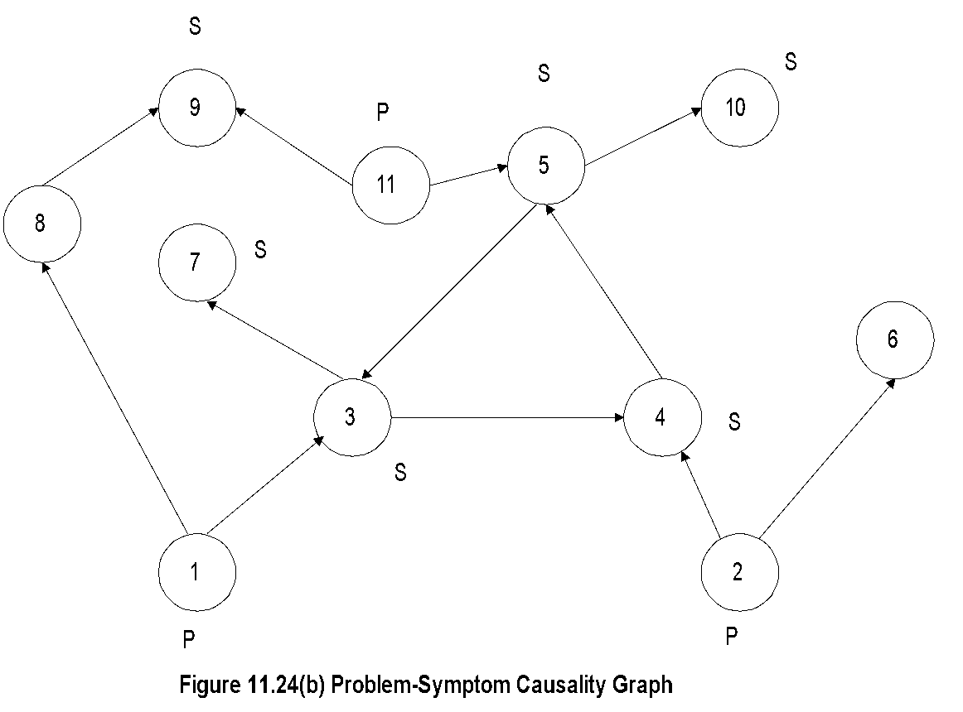
Chapter 11 Network Management Applications
P-S Causality Graph
Figure 11.24(b) shows the equivalent problem-symptom causality graph.
We will now reduce the causality graph to a correlation graph.
Figure 11.24 Generalized Causality Graph
  Notes
To reduce causality graph to correlation graph:
  Symptoms 3, 4, and 5 are cyclical: replace with one symptom, say 3
  S7 and S10 are caused by S3 and S5 and hence ignored
  S8 causes S9. Keep S9 and eliminate S8; reason for this would be more obvious if we go through reduction of codebook to correlation matrix

Slide 39
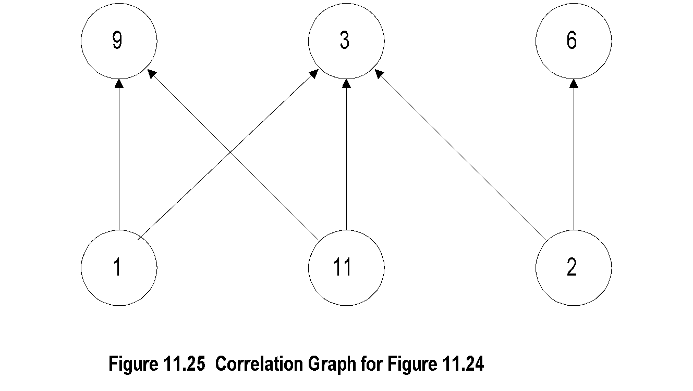

Chapter 11 Network Management Applications
Correlation Graph and Matrix
Further refinements can be made in the codebook approach to event correlation in terms of tolerance to spurious noises and probability relationship in the causality graph.
We have derived the correlation matrix to be the minimal causal matrix. Thus, each column in the code matrix is differentiated from other columns by at least one bit (i.e., value in one cell).
  Notes
Figure 11.26 Correlation Matrix for Figure 11.24
Note that problems 1 and 11 produce identical
symptoms

Slide 40
Chapter 11 Network Management Applications
Codebook Enhancements
Codebook described so far assumes Hamming
distance of 1 for uniqueness
Noise affects accuracy
Increase Hamming distance to >1
Probability of a problem causing a symptom
assumed as 1. It can be made Si = Pr(Pj) to
be more realistic
  Notes
From coding theory, this corresponds to a Hamming distance of one. Any spurious noise in the event detection could change one of the bits and thus a code word would identify a pair of problems. This could be avoided by increasing the Hamming distance to two or more, which would increase the number of symptoms in the correlation matrix. Also, the relationship between a problem and symptoms could be defined in terms of probability of occurrence, and the correlation matrix would be a probabilistic matrix. The codebook correlation technique has been implemented in In Charge system developed by System Management ARTS (SMARTS)

Slide 41
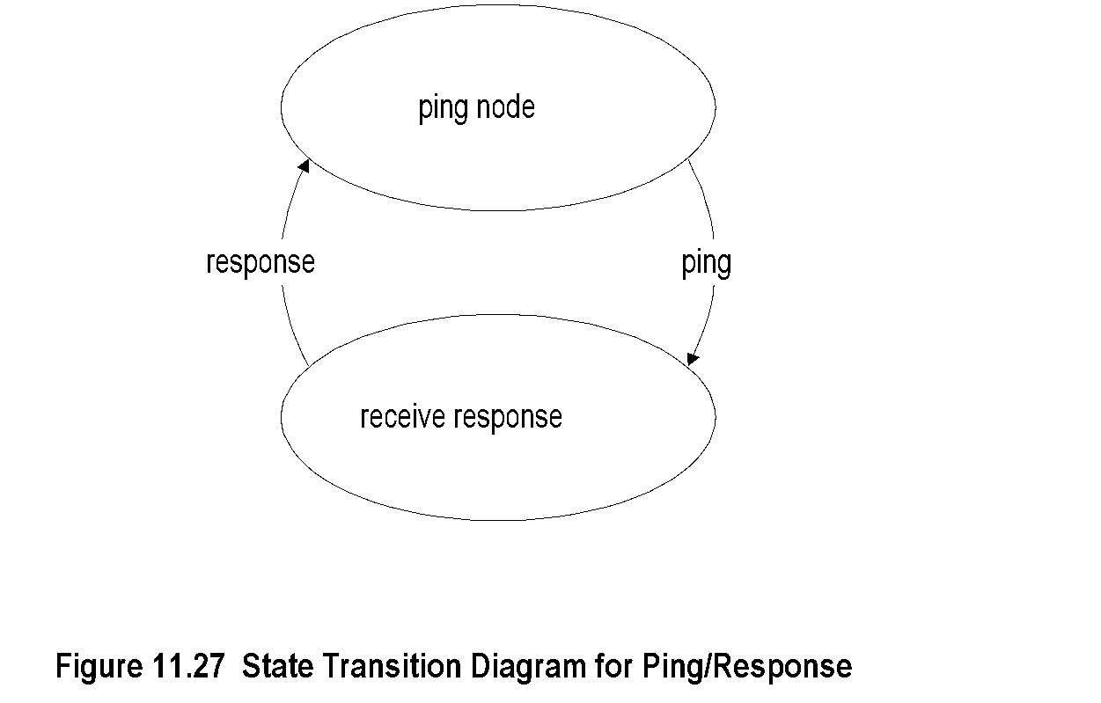
Chapter 11 Network Management Applications
State Transition Model
11.4.5 State Transition Graph Model
A state transition graph model is used by Seagate's NerveCenter correlation system. This could be used as a stand-alone system or integrated with an NMS, which HP OpenView and some other vendors have done.
A simple state diagram with two states for a ping/response process is shown in Figure 11.27.
The two states are ping node and receive response. When an NMS sends a ping, it transitions from the ping node state to the receive response state. When it receives a response, it transitions back to the ping node state.
  Notes
Used in Seagate’s NerveCenter correlation system
Integrated in NMS, such as OpenView
Used to determine the status of a node

Slide 42
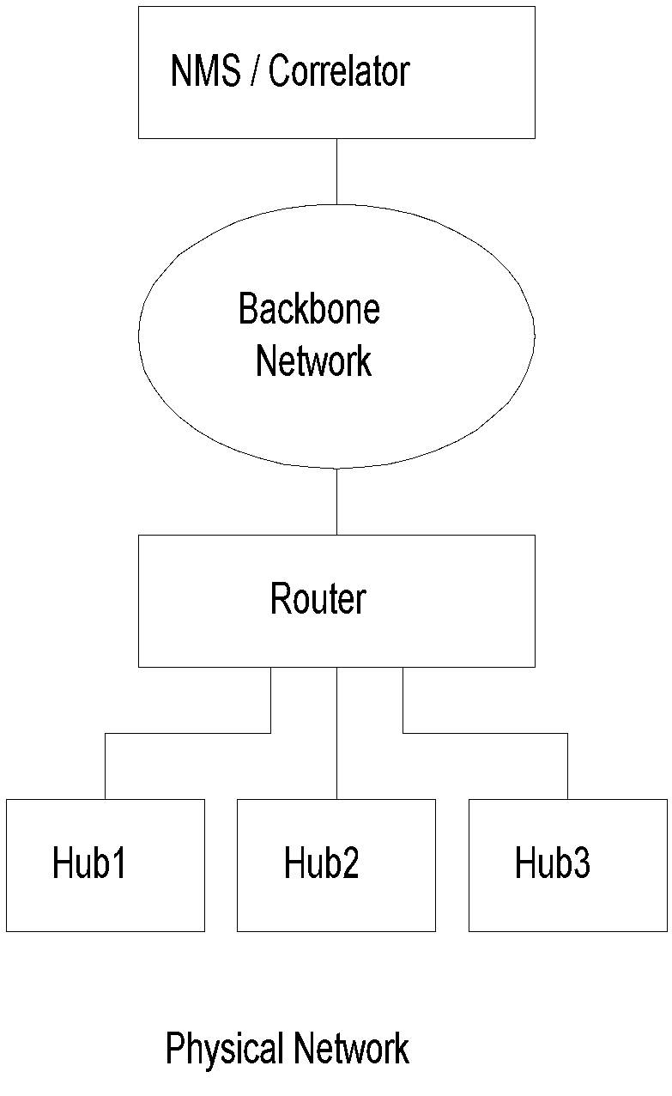
Chapter 11 Network Management Applications
State Transition Model Example
It is best to illustrate with an example of how a state transition diagram could be used to correlate events in the network. Let us choose the same example as in model-based reasoning, Figure 11.11.
An NMS is pinging the hubs that are accessed via a router. Let us follow through the scenario of the NMS pinging a hub. When the hub is working and the connectivity to the NMS is good, a response is received for each ping sent, say every minute, by the NMS. This is represented by the top two states, ping hub and receive response, on the left side of Figure 11.28.
  Notes
NMS pings hubs every minute
Failure indicated by the absence of a response

Slide 43
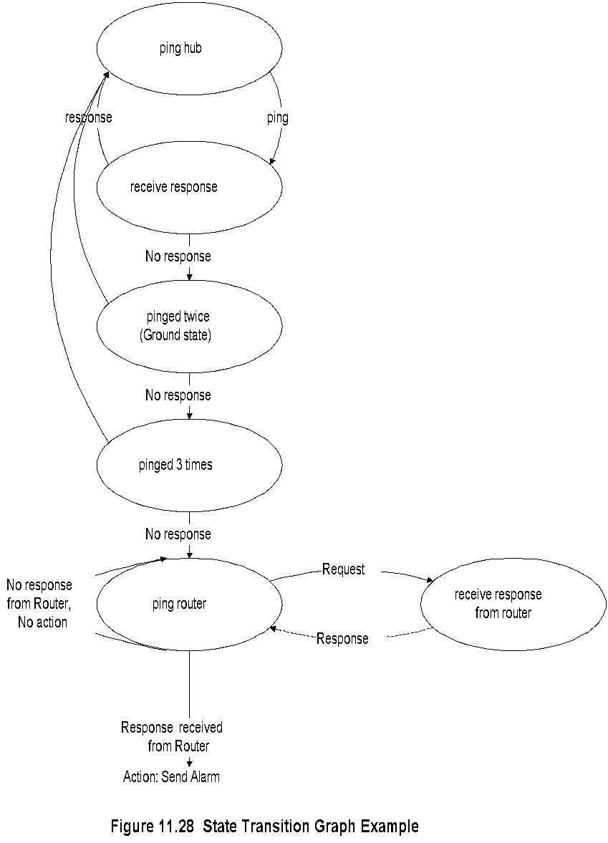
Chapter 11 Network Management Applications
Let us now consider the situation when a response for a ping is not received before the next ping is ready to be sent. NMS typically expects a response in 300 milliseconds (we are not pinging some obscure host in a foreign country!).
An action is taken by the NMS and the state transitions from receive response to pinged twice (referred to as ground state by NerveCenter). It is possible that a response is received for the second ping and in that situation the state transitions back to the normal ping hub state.
However, if there is no response for the second ping, NMS pings a third time. The state transition is now pinged three times. The response for this ping will cause a transition to the ping hub state.
However, let us consider the situation of no-response for the third ping. Let us assume that the NMS is configured to ping three times before it declares that there is a communication failure between it and the hub. Without any correlation, an alarm will be triggered and the icon representing the hub would turn red.
There are two possible outcomes now. The connectivity to the router is lost and no response is received from the router. The system takes no action, which is indicated by the closed loop in the ping router state.
The second possibility is that a response is received from the router. This means that the connection to the hub is lost. Now, the correlator in the NMS triggers an alarm that turns the hub icon red.
We notice that in the scenario of a router connectivity failure, only the router icon turns red and none of the hubs connected to it turn red, thus identifying the root cause of the problem.
State Transition Graph

Slide 44
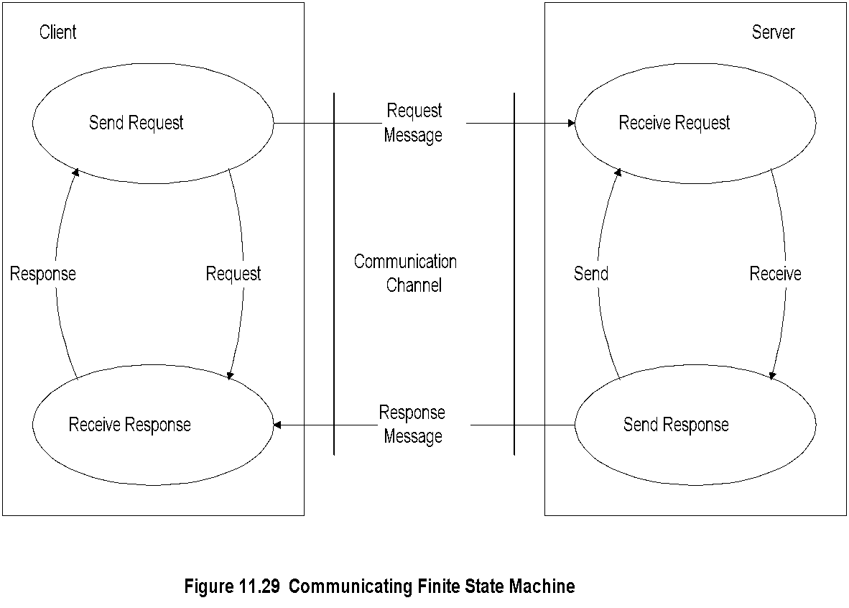
Chapter 11 Network Management Applications
Another model-based fault detection scheme uses the communicating finite state machine, The main claim of this process is that it is a passive testing system. Itis assumed that an observer agent is present in each node and reports abnormality to a central point. We can visualize the node observer as a Web agent and the central point as the Web server.
An application on the server correlates the events. A failure in a node or a link is indicated by the state machine associated with the component entering an illegal state.
A simple communicating finite state machine for a client-server system is shown in Figure 11.29.
It presents communication between a client and server via a communication channel. For simplicity, both the client and the server are assumed to have two states each. The client, which is in send request state, sends a request message to the server, and transitions to receive the response state. The server is currently in the receive request state. The server receives the request and transitions to the send response state. After processing the request, it sends the response and transitions back to the receive request state.
The client then receives the response from the server and transitions to the send request state.
If either the client or the server enters an illegal state during the transitions, the system has encountered a fault.
For example, after sending a response, if the server does not transition to receive a request state, it is in a failed state. A message is sent to a central location under a fault condition either by the component itself or by the one communicating with the failed component. This is a passive detection scheme similar to the trap mechanism.
We can observe a similarity between the finite state machine model and the state transition graph model with regard to state transitions. However, the main difference is that the former is a passive system and the latter is an active one.
Finite State Machine Model
  Notes
Finite state machine model is a passive system;
state transition graph model is an active system
An observer agent is present in each node and reports abnormalities, such as a Web agent
A central system correlates events reported by the agents
Failure is detected by a node entering an illegal state

Slide 45
Security Management
Security threats
Policies and Procedures
Resources to prevent security breaches
Firewalls
Cryptography
Authentication and Authorization
Client/Server authentication system
Message transfer security
Network protection security
  Notes

Slide 46
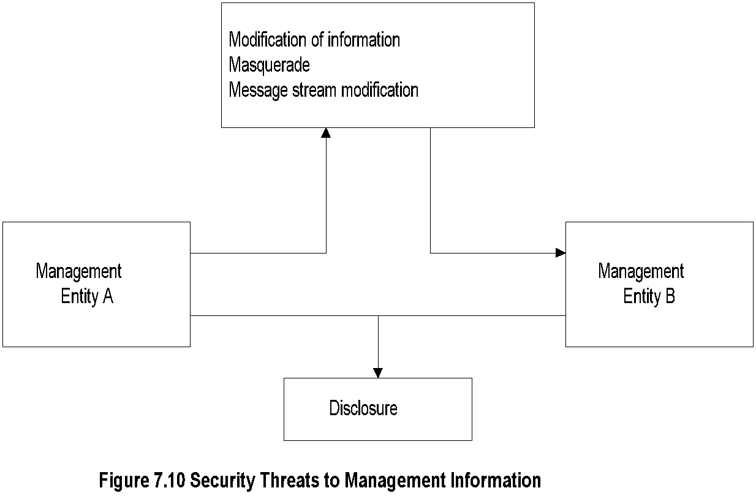
Security Threats
Security management is both a technical and an administrative issue in information management. It involves securing access to the network and information flowing in the network, access to data stored in the network, and manipulating the data that are stored and flowing across the network. The scope of network and access to it not only covers enterprise intranet network, but also the Internet that it is connected to.
Another area of great concern in secure communication is communication with mobile stations.
In Chapter 7 we covered several of the security issues associated with SNMP management as part of SNMPv3 specifications and discussed possible security threats. Four types of security threats to network management were identified: modification of information, masquerade, message stream modification, and disclosure.
They are applicable to security in the implementation of security subsystems in the agent (authoritative engine) and in the manager (non-authoritative engine).
The SNMPv3 security subsystem is the User-Based Security Model (USM). It has two modules — an authentication module and a privacy module. The former addresses data integrity and data origin; the latter is concerned with data confidentiality, message timeliness, and limited message protection. The basic concepts discussed in Chapter 7 are part of generalized security management in data communications.
Security management goes beyond the realm of SNMP management. In this section, we will address policies and procedures, resources to prevent security breaches, and network protection from software attacks.
  Notes
SNMPv3 addressed security threats using USM
(user-based security model)
USM has two modules:
  Authentication module
    Data integrity
    Data origin
  Privacy module
    Data confidentiality
    Message timeliness
    Message protection

Slide 47
Chapter 11 Network Management Applications
Policies and Procedures
The basic guide to setting up policies and procedures is:
1. Identify what you are trying to protect
2. Determine what you are trying to protect it from
3. Determine how likely the threats are
4. Implement measures, which will protect your assets in a cost-effective manner
5. Review the process continuously and make improvements to each item if a weakness is found
SNMP management addressed this in terms of a community access policy for network management information
The National Computer Security Center (NCSC) has published what is known as the Orange Book, which defines a rating scheme for computers. It is based on the security design features of the computer. The issues for corporate site security using the intranet are the same as for the Internet and are applicable to them equally. It is a framework for setting security policies and procedures. The basic guide to setting up policies and procedures is:
The assets that need to be protected should be listed including hardware, software, data, documentation, supplies, and people who have responsibility for all of the above.
Denial of service is a serious attack on the network. The network is brought to a state in which it can no longer carry legitimate users' data. This is done either by attacking the routers or by flooding the network with extraneous traffic.
  Notes
References:
  Formal statement of rules for protecting
  organization’s technology and assets (RFC
  2196)
  Introduction to Firewalls (NIST)
  Orange Book by National Computer Security
  Center (NCSC) rates computers based on
  security design features

Slide 48
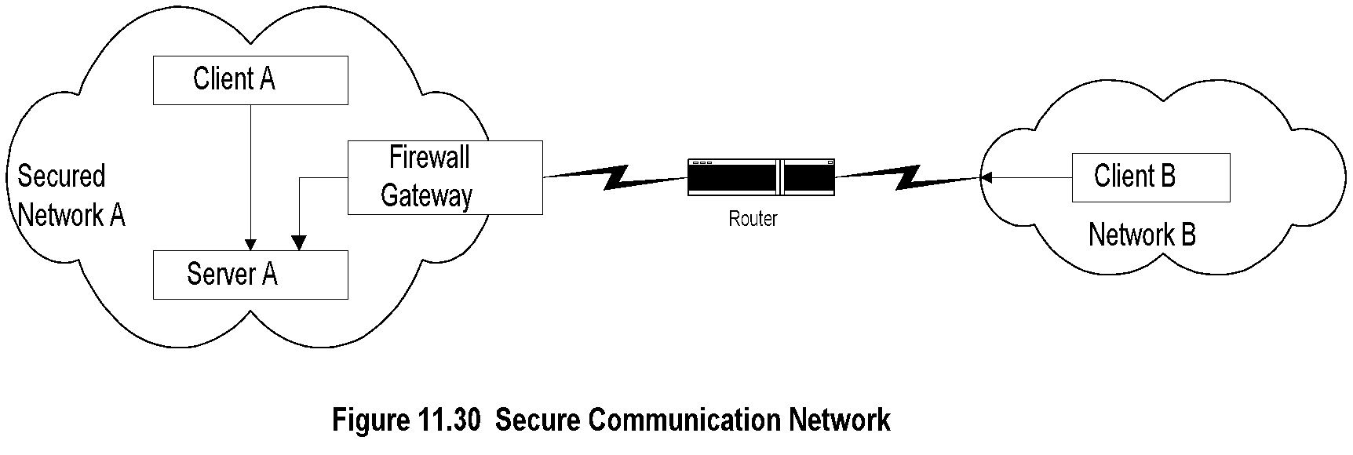
Chapter 11 Network Management Applications
we will discuss various security breaches that are attempted to access data and systems, and the resources available to protect them.
Figure 11.30 shows a secure communication network, there is no fully secure system in the real world; there are only systems which are hard and time-consuming to break into.
Figure 1 1.30 shows two networks communicating with each other via a WAN, which has just one router. Server A and Client A shown in Network A are communicating with each other; and Client B in Network B is also communicating (or trying to communicate) with Server A in Network A.
Let us look at the security breach points in this scenario. Hosts in Network B may not have the privilege to access Network A. The firewall gateway shown in Figure 11.30 is used to screen traffic going in and out of secure Network A. Even if Network B has access permission to Network A, some intruder, for example one who has access to the router in the path, may intercept the message. The contents of the message, as well as source and destination identifications, can be monitored and manipulated, which are security breaches.
Security breaches can occur in the Internet and intranet environment in numerous ways. Inmost corporate environments, security is limited to user identification and password. Even the password is not changed often enough. This is the extent of authentication.
Authorization is limited to the establishment of accounts, i.e., who can log into an application on a host. Besides normal activities of breach, we have to protect against special situations, such as when a disgruntled employee could embed virus programs in company programs and products.
Secure Communication Network
  Notes
Firewall secures traffic in and out of Network A
Security breach could occur by intercepting the
message going from B to A, even if B has
permission to access Network A
Most systems implement authentication with user
id and password
Authorization is by establishment of accounts

Slide 49
Firewalls
Protects a network from external attacks
Controls traffic in and out of a secured network
Could be implemented in a router, gateway, or a special host
Benefits
  Reduces risks of access to hosts
  Controlled access
  Eliminates annoyance to the users
  Protects privacy (e.g., finger)
  Hierarchical implementation of policy and technology (e.g., finger)
  Notes

Slide 50
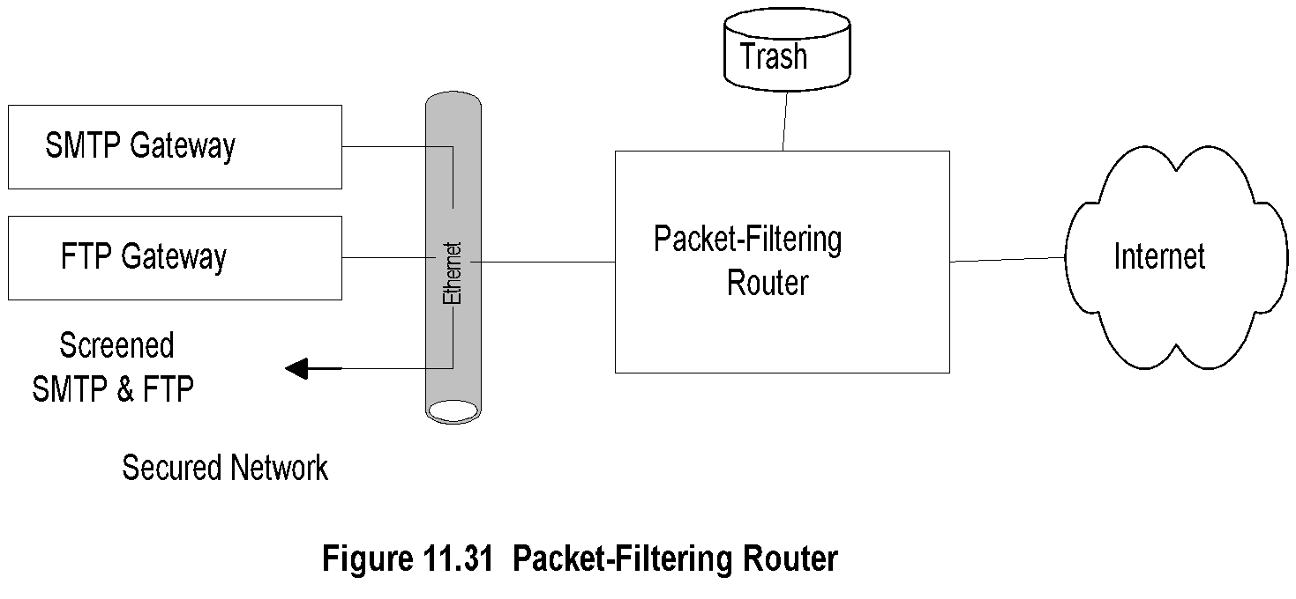
Chapter 11 Network Management Applications
Packet Filtering Firewall
Firewalls use packet filtering or application-level gateways as the two primary techniques of controlling undesired traffic.
Packet Filters.
Packet filtering is the ability to filter packets based on protocol-specific criteria. It is done at the OSI data link, network, and transport layers.
Packet filters are implemented in some commercial routers, called screening routers or packet-filtering routers.
We will use the generic term of packet-filtering routers here. Although routers do not look at the transport layers.
The filtering is done on the following parameters: source IP address, destination IP address, source TCP/UDP port, and destination TCP/IP port.
Packet-filtering routers can either drop packets or redirect them to specific hosts for further screening, as shown in Figure 11.31. Some of the packets never reach the local network as they are trashed.
A packet-filtering firewall works well when the rules to be implemented are simple.
  Notes
Uses protocol specific criteria at DLC, network,
and transport layers
Implemented in routers - called screening router
or packet-filtering routers
Filtering parameters:
  Source and/or destination IP address
  Source and/or destination TCP/UDP port
  address, such as ftp port 21
Multistage screening - address and protocol
Works best when rules are simple

Slide 51
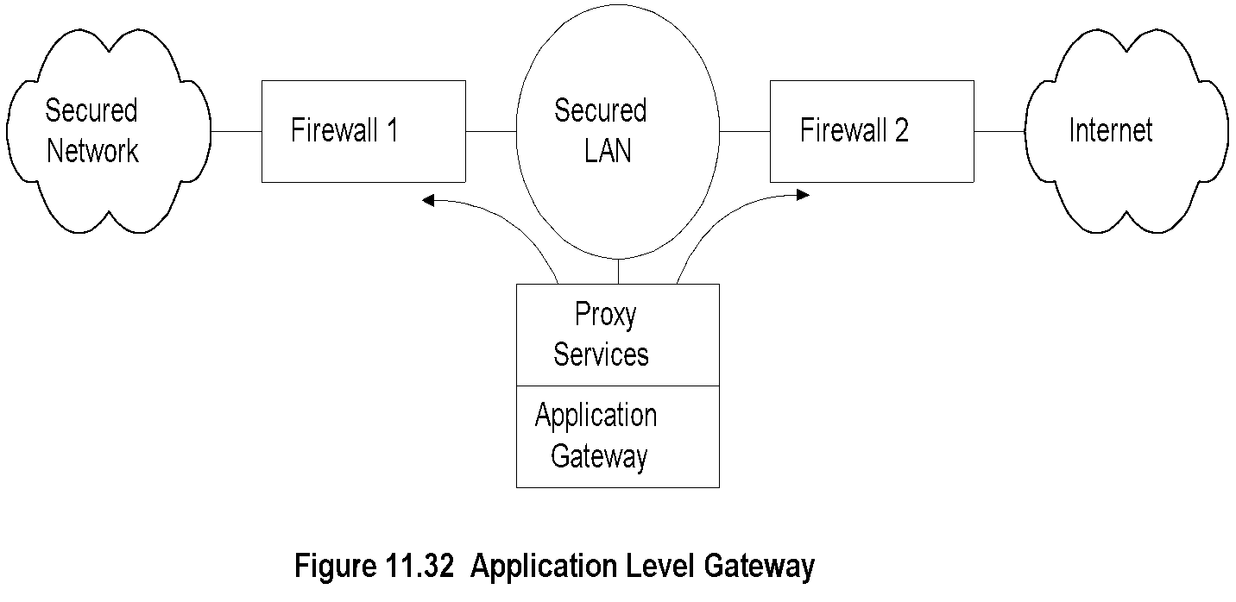
Chapter 11 Network Management Applications
Application Level Gateway
An application-level gateway is used to overcome some of the problems identified in packet filtering.
Figure 11.32 shows the application gateway architecture.
Firewalls F1 and F2 will only forward if data are to or from the application gateway.
The application gateway behaves differently for each application, and filtering is handled by the proxy services in the application gateway.
For TELNET service, the application gateway verifies the authentication of the foreign host, the legitimacy to communicate with the local host, and then makes the connection between the gateway and the local host. It keeps a log of all transactions.
Firewalls protect a secure site by checking addresses (such as IP address), transport parameters (such as FTP, NNTP), and applications. However, how do we protect access from an external source based on the user, who is using a false identification? Moreover, how do we protect against an intruder manipulating the data while they are traversing the network between the source and the destination? These concerns are addressed by secure communication.
  Notes
Firewalls 1 and 2 route traffic only from and to
the secured LAN
Secured LAN is gateway LAN
Behavior of application gateway dependent on
the application
FTP traffic stored and forwarded after validation
TELNET hosts validated for the session and then
direct communication established

Slide 52
Cryptography
For secure communication, we need to ensure integrity protection and authentication validation.
Integrity protection makes sure that the information has not been tampered with as it traverses between the source and the destination.
Authentication validation validates the originator identification.
These two important aspects address the four security threats — modification of information, masquerade, message stream modification, and disclosure.
Besides the actual message, control and protocol handshakes need to be secure. There are hardware solutions to authentication. However, it is not a complete solution, including the user identification and password.
The technology that is best suited to achieving secure communication is software based. Its foundation lies in cryptography. Hashing or message digest, and digital signature, are built on top of it to achieve integrity protection and source authentication.
Cryptography means secret (crypto) writing (graphy). It deals with techniques of transmitting information.
The basic model of cryptographic communication is shown in Figure 11.33.
The basic model of cryptographic communication is shown in Figure 11.33.
The input message, called plaintext, is encrypted by the encryption module using a secret (encryption) key.
The encrypted message is called ciphertext, which traverses through an unsecure communication channel, the Internet for example. The ciphertext is unintelligible information. At the receiving end, the decryption module deciphers the message with a decryption key to retrieve the plaintext.
The first known example of cryptography is the Caesar cipher. In this scheme, each letter is replaced by another letter, which is three letters later in the alphabet (i.e., key of 3). Thus, the plaintext, network management, will read as qhwzrun pdqdjhphqw in ciphertext. Of course, the receiver knew ahead of time the secret key (3) for successfully decrypting the message back to the plaintext network management by moving each letter back three positions.
tampered ; manipulate
traverses ; cross

Slide 53
Chapter 11 Network Management Applications
Cryptography التشفير
Secure communication requires
  Integrity protection: ensuring that the message
  is not tampered with
  Authentication validation: ensures the originator
  identification
Security threats
  Modification of information
  Masquerade
  Message stream modification
  Disclosure
Hardware and software solutions
Most secure communication is software based
  Notes
tampered ; manipulate
traverses ; cross

Slide 54
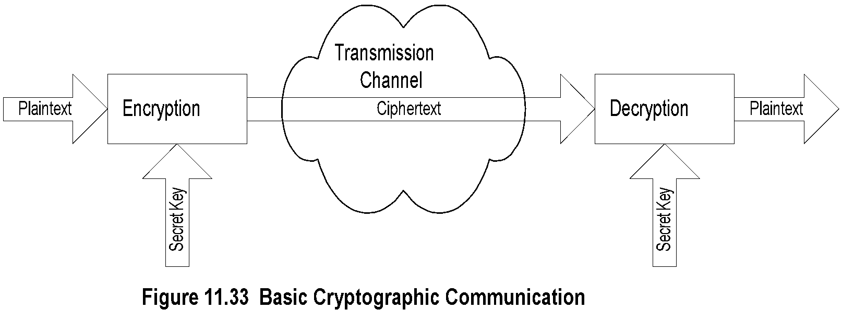
Chapter 11 Network Management Applications
Secret Key Cryptography
The Caesar cipher
Each letter is replaced by another letter n letters later in the alphabet and the sender and the receiver have to agree ahead on the secret key, It is the same key that is used for encryption and decryption and is called secret key cryptography. The encryption and decryption modules can be implemented in either hardware or software. It is not hard to decode the above ciphertext by an intruder. It would only take a maximum of 26 attempts to decipher since there are 26 letters in the alphabet.
Another encryption scheme, monoalphabetie cipher, is to replace each letter uniquely with another letter that is randomly chosen.
Two standard algorithms implement secret key cryptography, Data Encryption Standard (DES) and International Data Encryption Algorithm (IDEA).
They both deal with 64-bit message blocks and create the same size ciphertext. DES uses a 56-bit key and IDEA uses a 128-bit key. DES is designed for efficient hardware implementation and consequently has a poor performance if implemented in software. In contrast to that, IDEA functions efficiently in software implementation. The bits in the plaintext block are rearranged using a predetermined algorithm and the secret key several times.
A message that is longer than the block length is divided into 64-bit message blocks. There are several algorithms to break the message. One of the more popular ones is the cipher block chaining (CBC) method.
  Notes
Caesar cipher: each letter replaced by another
letter, which is three letters behind in the alphabet
Maximum of 26 attempts to decode Caesar cipher
Monoalphabetic cipher: Replace a letter with another
randomly chosen; Maximum attempts to decode 26!
One secret key is needed between each pair
Two standard algorithms for secret key:
  DES (Data Encryption Standard):
  64-bit message blocks and 56-bit key
  IDEA (International Data Encryption Algorithm):
  64-bit message blocks and 128-bit key
Message block derived using CBC (Cipher Block Chaining)
Principle based on rearranging the blocks several
times based on predetermined algorithm and secret key

Slide 55
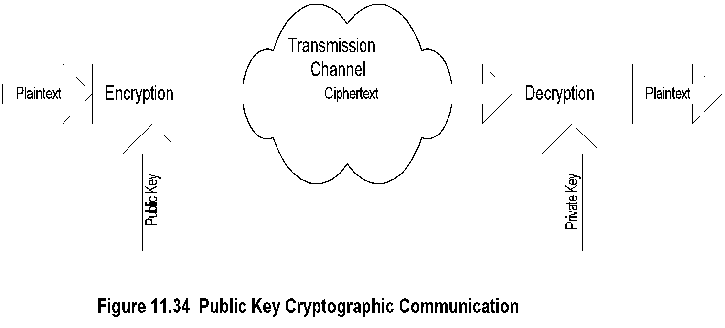
Chapter 11 Network Management Applications
Public Key Cryptography
Each user has to have a secret key
Secret key cryptography is symmetric in that the same key is used for encryption and decryption, but public key cryptography is asymmetric with a public key and a private key (not secret key, remember secret key is symmetric and private key is not).
In Figure 11.34, the public key of Ian is the key that everybody else (that Ian wants to communicate with) would know and use to encrypt messages to Ian.
The private key, which only Ian knows, is the key that Ian would use to decrypt the messages. With this scheme, there is secure communication between Ian and his communicators on a one-to-one basis.
The Diffe-Hellman public key algorithm is the oldest public key algorithm.
The commonly used public key cryptography algorithm is RSA, It does both encryption and decryption as well as digital signatures.
  Notes
Asymmetric cryptography - public and private key
Public key is distributed by the receiver to the
senders to encrypt the message.
Private key is used by receiver to decode
ciphertext
Mailbox analogy
Commonly used public key is RSA (Rivest, Shamir,
and Adleman); 512-bit key, variable block size
RSA less efficient than DES and IDEA; used to
encrypt secret key

Slide 56

Chapter 11 Network Management Applications
Message Digest
Message digest is a cryptographic hash algorithm
added to a message
One-way function
Analogy with CRC
If the message is tampered with the message
digest at the receiving end fails to validate
MD5 (used in SNMPv3) commonly used MD
MD5 takes a message of arbitrary length (32-byte)
blocks and generates 128-bit message digest
SHS (Secure Hash Standard) message digest
proposed by NIST handles 2⁶⁴ bits and generates
160-bit output
the cyclic redundancy check (CRC) detection of errors in digital transmission. This involves calculating a check sum based on the data in the frame or packet at the sending end and transmitting it along with the data.
The CRC, also known as checksum, is computed at the receiving end and is matched against the received checksum to ensure that the packet is not corrupted.
An analogous principle is used in validating the integrity of the message. In order to ensure that the message has not been tampered with between the sender and the receiver, a cryptographic CRC is added with the message. This is derived using a cryptographic hash algorithm, called message digest (MD). There are several versions, such as MD5.
A second algorithm used to obtain a hash or message digest is the Secure Hash Standard (SHS).
Some significant features of the message digest are worth mentioning. First, there is a one-to-one relationship between the input and the output messages.
Lastly, the generation of a message digest is a one-way function.
  Notes
Example:

Slide 57
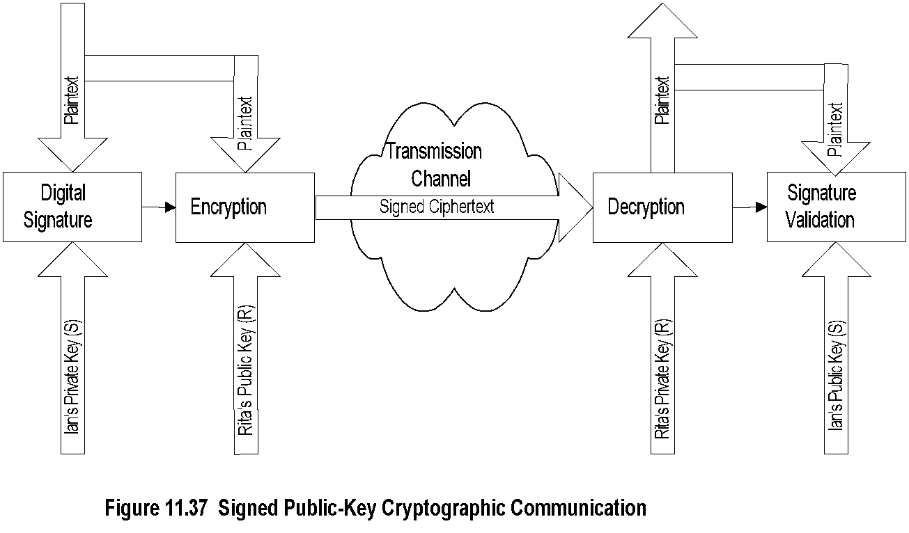
Chapter 11 Network Management Applications
Digital Signature
Digital Signature.
In public key cryptography, or even in secret key cryptography, if Rita receives a message claiming that it is from Ian, there is no guarantee as to who sent the message.
The digital signature works in the reverse direction from that of public key cryptography.
Notice that only the originator can create the digital signature with his private key and others can look at it with the originator's public key and validate it, but cannot create it.
Digital signature is valuable in electronic commerce.
  Notes
Why do we need digital signature?
Principle reverse of public key
Signature created using private key and validated
using public key
Digital signature is a message digest generated from
plaintext and private key by a hashing algorithm
Digital signature is concatenated with the plaintext
and encrypted using public key

Slide 58
Chapter 11 Network Management Applications
Authentication and Authorization
Authentication is the verification of the user's identification, and authorization is the access privilege to the information.
the user's identification and password, which are used for authentication
There are several secure mechanisms for authentication, depending on complexity and sensitivity.
Authorization to use the services could be a simple read, write, read-write, or no-access for a particular service.
The privilege of using the service could be for an indefinite period, or a finite period, or just for one-time use.
There are two main classes of systems of an authentication scheme:
The first class the client-server environment in which there is a request-response communication between the client and the server.
The second class of service is a one-way communication environment, such as email or e-commerce transaction. The message transmitted by the source is received by the receiver
Authentication verifies user identification
  Client/server environment
    Ticket-granting system
    Authentication server system
    Cryptographic authentication
  Messaging environment
    e-mail
    e-commerce
Authorization grants access to information
  Read, read-write, no-access
  Indefinite period, finite period, one-time use
  Notes

Slide 59
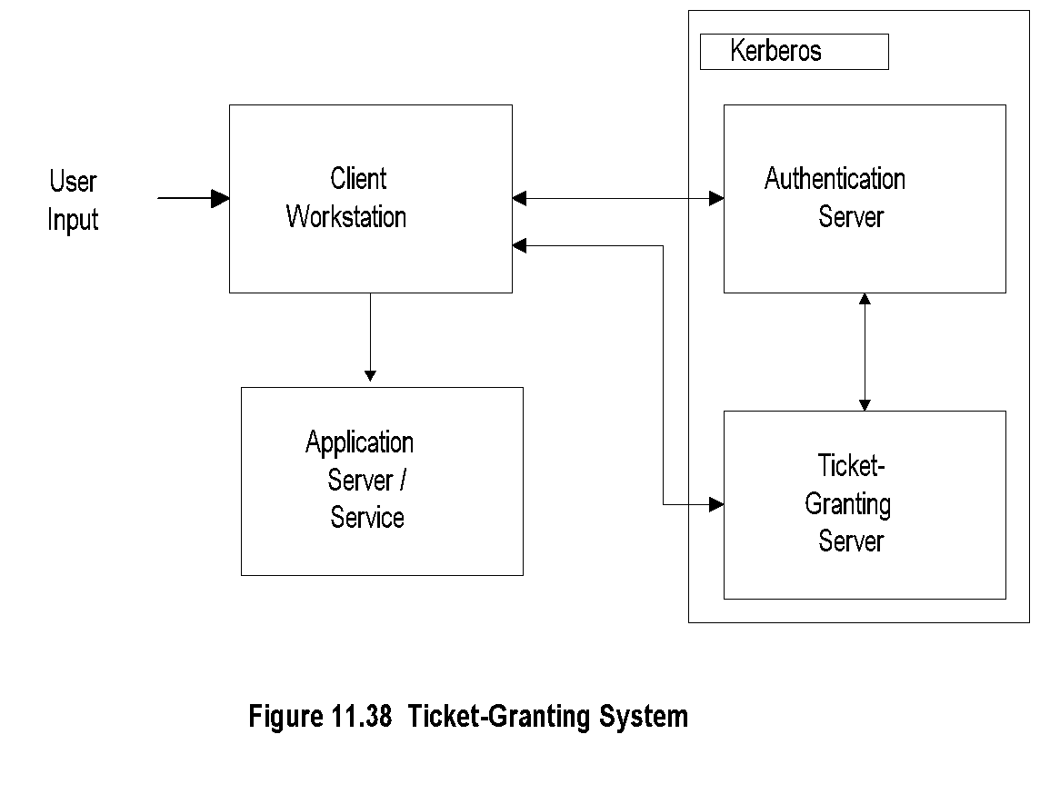
Chapter 11 Network Management Applications
Ticket-Granting System
Client-Server Authentication Systems
the implementation of authentication function in each: host/user environment, a ticket-granting system, an authentication system, and authentication using cryptographic function.
Host/User Authentication.
Host authentication involves certain hosts to be validated by the server providing the service. The server recognizes the host by the host address. user authentication, which is done by the user providing identification and a password. The main problem with the password is that it is detected easily by eavesdropping, say using a network probe. To protect against the threat of eavesdropping, the security is enhanced by encrypting the password before transmission.
Ticket-Granting System.
Figure 11.38 shows the ticket-granting system with Kerberos. Kerberos consists of an authentication server and a ticket-granting server. The user logs into a client workstation and sends a login request to the authentication server. After verifying that the user is on the access control list, the authentication server gives an encrypted ticket-granting ticket to the client. The client workstation requests a password from the user, which it uses to decrypt the message from the authentication server. The client then interacts with the ticket-granting server and obtains a service-granting ticket and a session key to use the application server.
  Notes
Used in client/server authentication system
Kerberos developed by MIT
Steps:
  User logs on to client workstation
  Login request sent to authentication server
  AS checks ACL, grants encrypted ticket to client
  Client obtains from TGS service-granting ticket
  and session key
  Application Server validates ticket and session key,
  and then provides service

Slide 60
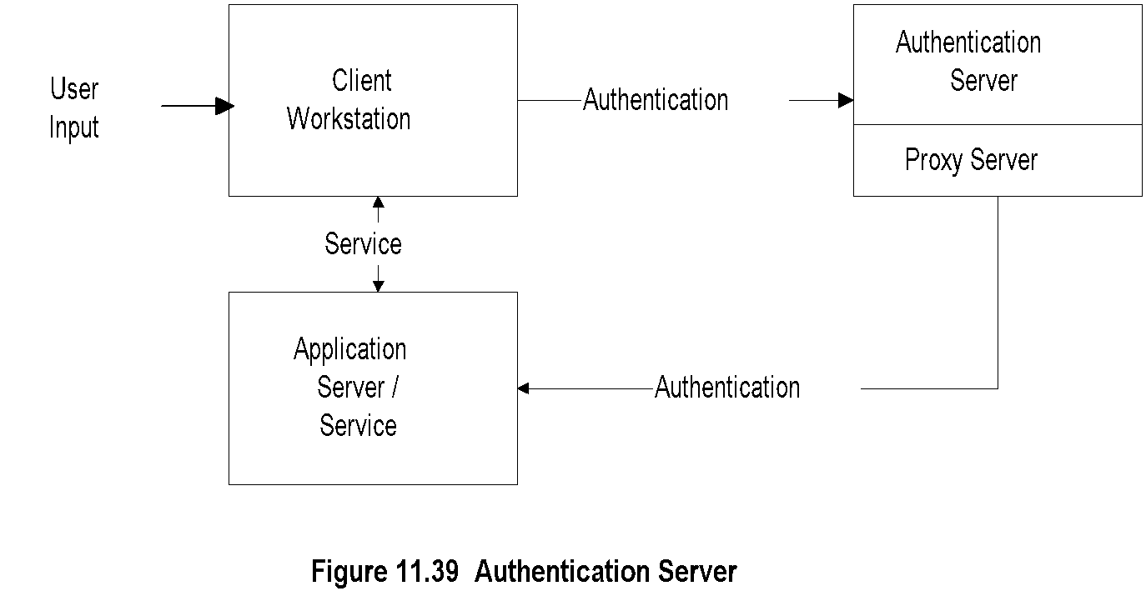
Chapter 11 Network Management Applications
Authentication Server System.
An authentication server system, shown in Figure 1 1.39, is somewhat similar to the ticket-granting system except that there is no ticket granted. No login identification and password pair is sent out of the client workstation. The user authenticates to a central authentication server, which has jurisdiction over a domain of servers. The central authentication server, after validation of the user, acts as a proxy agent to the client and authenticates the user to the application server. This is transparent to the user, and the client proceeds to communicate with the application server. This is the architecture of Novell LAN.
Authentication Using Cryptographic Functions. Cryptographic authentication uses cryptographic functions. The sender can encrypt an authentication request to the receiver, who decrypts the message to validate the identification of the user. Algorithms and keys are used to encrypt and decrypt messages, which we will address now.
Authentication Server
  Notes
Architecture of Novell LAN
Authentication server does not issue ticket
Login and password not sent from client workstation
User sends id to central authentication server
Authentication server acts as proxy agent to the client
and authenticates the user with the application server
Process transparent to the user

Slide 61
Chapter 11 Network Management Applications
Message Transfer Security
Messaging one-way communication
Secure message needs to be authenticated
and secured
Three secure mail systems
  Privacy Enhanced Mail (PEM)
  Pretty Good Privacy (PGP)
  X-400: OSI specifications that define
  framework; not implementation specific
  Notes
The one-way message transfer system is non-interactive.
There are three secure mail systems — privacy-enhanced mail (PEM), pretty good privacy (PGP), and X.400-based mail system

Slide 62
Chapter 11 Network Management Applications
Privacy Enhanced Mail
Developed by IETF (RFC 1421 - 1424)
End-to-end cryptography
Provides
  Confidentiality
  Authentication
  Message integrity assurance
  Nonrepudiation of origin
Data encryption key (DEK) could be secret or
public key-based originator and receiver agreed
upon method
PEM processes based on cryptography and
message encoding
  MIC-CLEAR (Message Integrity Code-CLEAR)
  MIC-ONLY
  ENCRYPTED
Privacy-Enhanced Mail (PEM).
It is intended to provide PEM using end-to-end cryptography between originator and recipient processes
The PEM provides privacy enhancement services (what else!), which are defined as
(1) confidentiality,
(2) authentication,
(3) message integrity assurance, and
(4) non-repudiation of origin.
The cryptographic key, called the data encryption key (DEK), could be either a secret key or a public key
The message integrity code (MIC) is generated digital signature and included as part of email in all three procedures.
The specification provides two types of keys — a data-encrypting key (DEK) and an interexchange key (IK).
  Notes

Slide 63
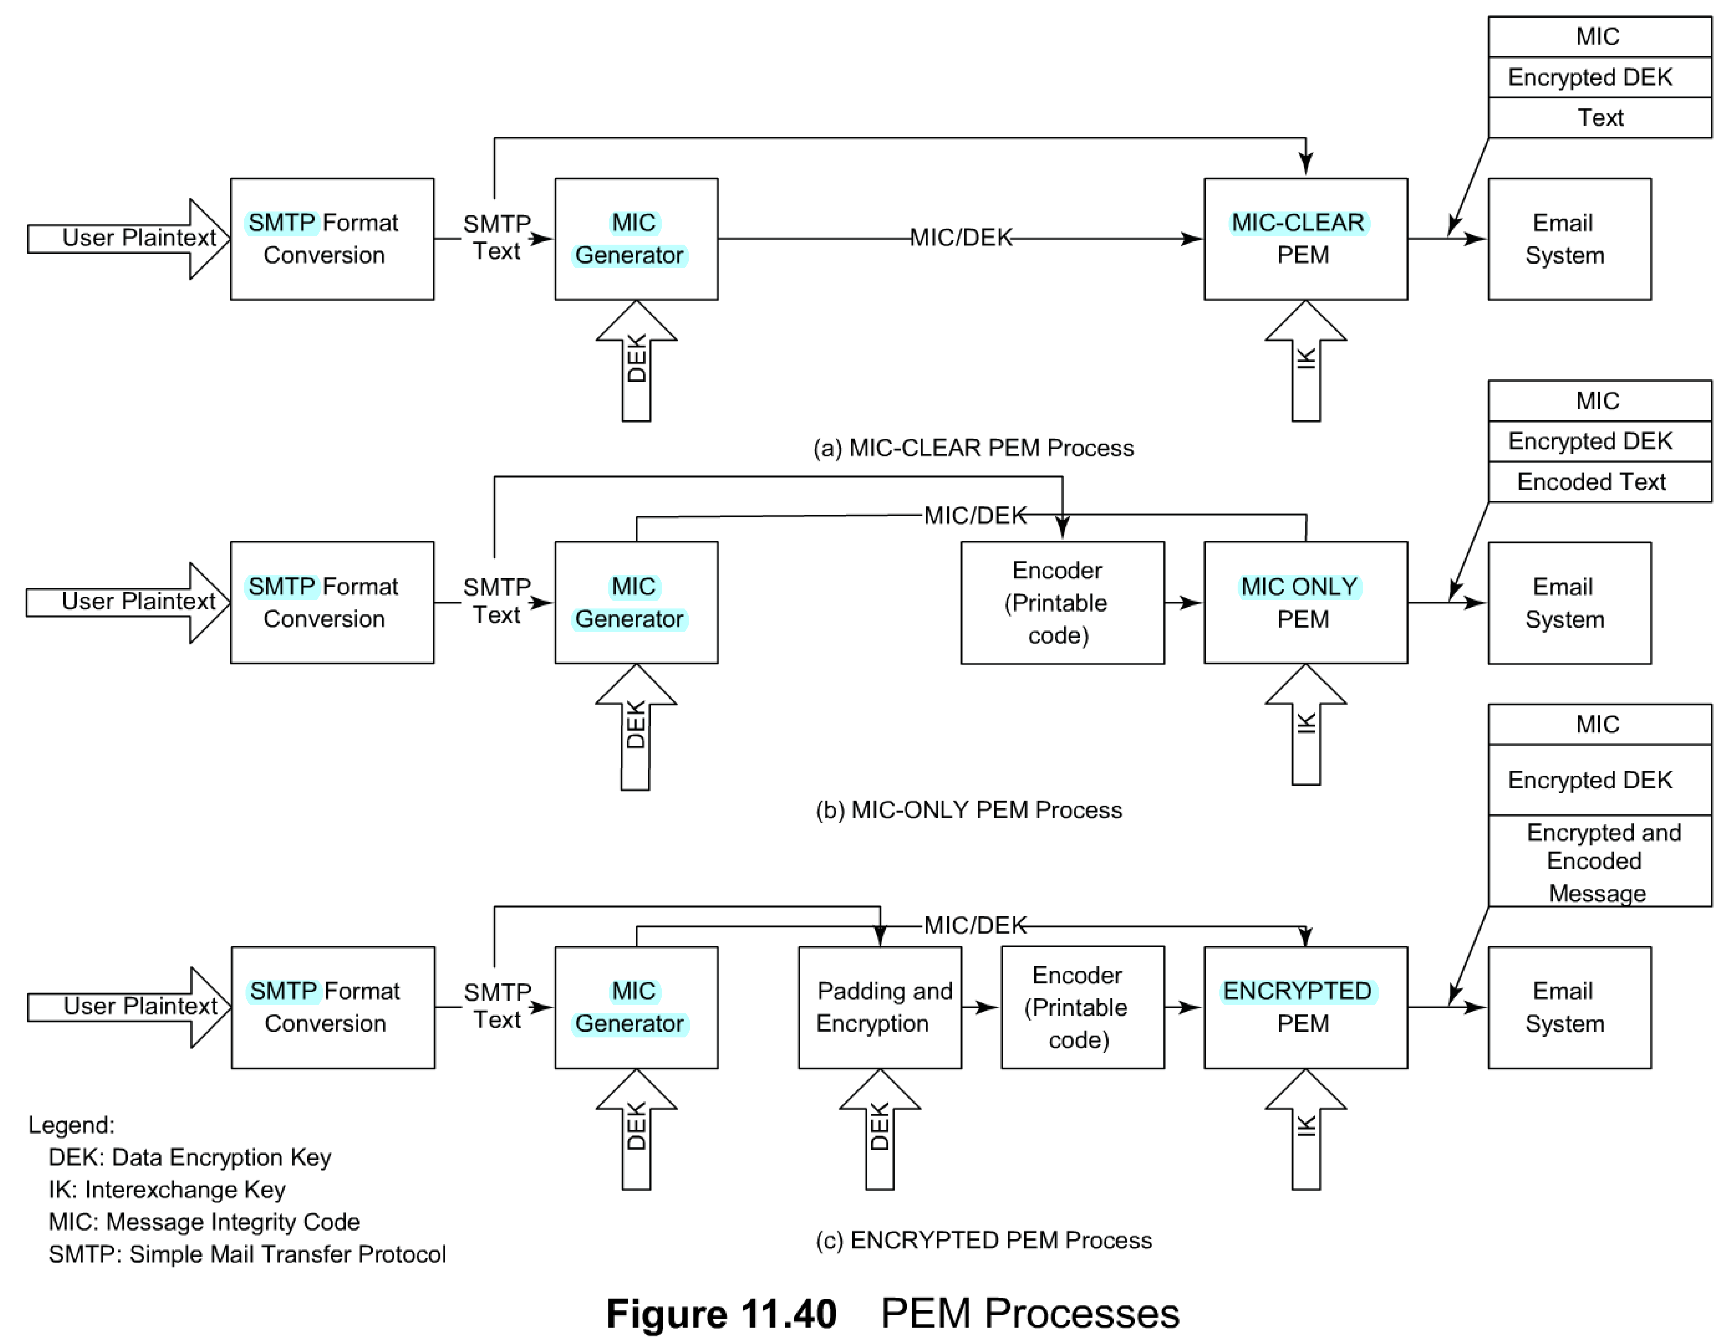
PEM Processes
Figure 11.40 shows three PEM processes defined by IETF: MIC-CLEAR, MIC-ONLY, and ENCRYPTED based on message integrity and encryption scheme.
Only the originating end is shown.
In all three procedures, reverse procedures are used to extract the message and validate the originator ID and message integrity.
The message integrity code (MIC) is generated as discussed in Section 11.5.4 on digital signature and included as part of email in all three procedures.
The specification provides two types of keys — a data-encrypting key (DEK) and an interexchange key (IK).
The DEK is a random number generated on a per message basis. The DEK is used to encrypt the message text and also to generate an MIC, if needed.
The IK, which is a long-range key agreed upon between the sender and the receiver, is used to encrypt DEK for transmission within the message.
The MIC generated is concatenated with the SMTP text and is inserted as the text portion in the email.
Figure 1 1.40(a) shows the MIC-CLEAR procedure and is the simplest of the three. The MIC generated is concatenated with the SMTP text and is inserted as the text portion in the email.
In the MIC-ONLY procedure, shown in Figure 11.40(b), the SMTP text is encoded into a printable character set.
Figure 11.40(c) is the most sophisticated of the three procedures. The SMTP text is padded, if needed, and encrypted. A public key is the best choice here, because it guarantees the originator ID. The encrypted message, encrypted MIC, and the DEK are all encoded in printable code to pass through the mail system as ordinary text. They are concatenated and fed to the email system.
(Originating end نهاية الأصل)
  Notes
DEK a random number generated per message basis: used to encrypt the message text and generate MIC
IK a long-range key agreed upon between the sender receiver used to encrypt DEK: IK is either public or secret
Public key avoids repudiation

Slide 64
Chapter 11 Network Management Applications
Pretty Good Privacy
(Originating end)
PGP is a package in the sense defines a clever procedure that utilizes various available modules to perform the functions needed to transmit a secure message, such as email.
  Notes
PGP secure mail package developed by Zimmerman
Available in public domain
Signature generation
  Uses MD5 to generate hash code
  Encrypts hash code with sender’s private key
  using RSA algorithm
Encryption of the message done using IDEA or RSA
Compression done with ZIP
email conversion done using Radix-64
PGP similar to encrypted PEM with added compression

Slide 65
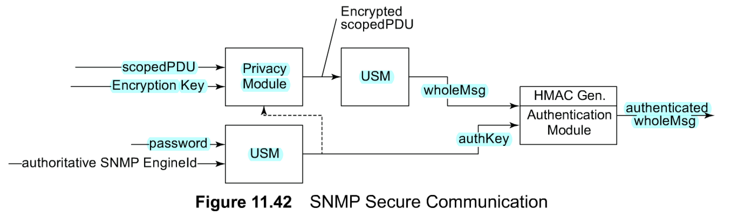
Chapter 11 Network Management Applications
SNMPv3 Security
We dealt with secure transmission in SNMPv3 in Chapter 7.Although an NMS-management agent behaves like a client-server system, the security features are similar to the message transfer cryptography.
In an NMS, the user password and authoritative SNMP engine ID (network management agent ID) are used to generate an authentication key by the USM.
(Outgoing message)
  Notes
Authentication key equivalent to DEK in PEM or private key in PGP
Authentication key generated using user password and SNMP engine id
Authentication key may be used to encrypt message
USM prepares the whole message including scoped PDU
HMAC, equivalent of signature in PEM and PGP, generated using authentication key and the whole message
Authentication module provided with authentication key and HMAC to process incoming message

Slide 66
Chapter 11 Network Management Applications
Virus Attacks
Executable programs that make copies and insert them into other programs
Attack hosts and routers
Attack infects boot track, compromises cpu, floods network traffic, etc.
Prevention is by identifying the pattern of the virus and implementing protection in virus checkers
  Notes

Slide 67
Chapter 11 Network Management Applications
Accounting Management
Least developed
Usage of resources
Hidden cost of IT usage (libraries)
Functional accounting
Business application
  Notes
Accounting management is probably the least developed function of network management application.
We have discussed the gathering of statistics using RMON probes in Chapter 8 and in Section 1 1.3.4.
Accounting management could also include the use of individual hosts, administrative segments, and external traffic.
Accounting of individual hosts is useful for identifying some hidden costs. For example, the library function in universities and large corporations consumes significant resources and may need to be accounted for functionally. This can be done by using the RMON statistics on hosts.
The cost of operations for an information management services department is based on the service that it provides to the rest of the organization. For planning and budget purposes, this may need to be broken into administrative group costs. The network needs to be configured so that all traffic generated by a department can be gathered from monitoring segments dedicated to that department.
External traffic for an institution is handled by service providers.
The tariff is negotiated with the service provider based on the volume of traffic and traffic patterns, such as peak traffic and average traffic.
Internal validation of the service provider's billing is a good management practice.

Slide 68
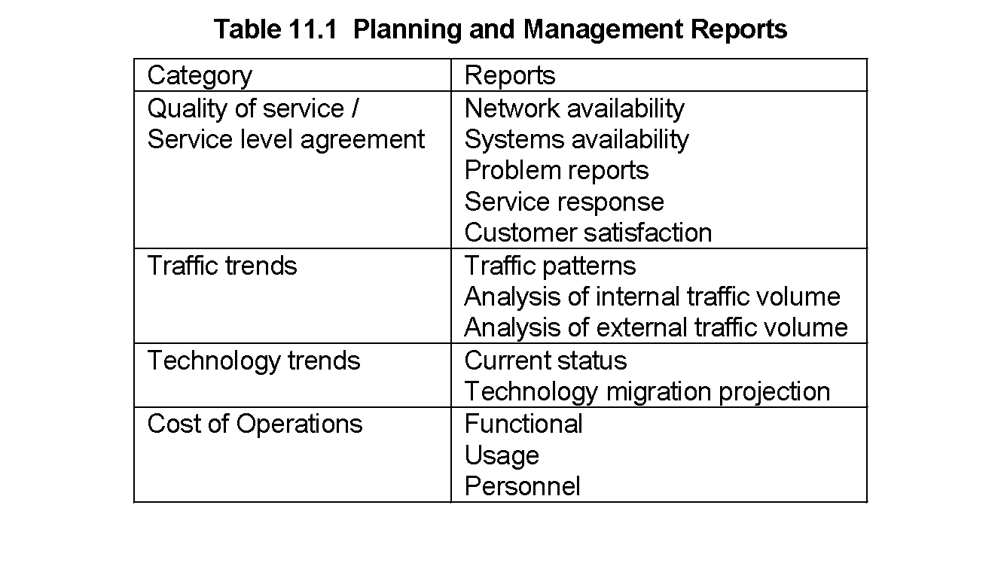
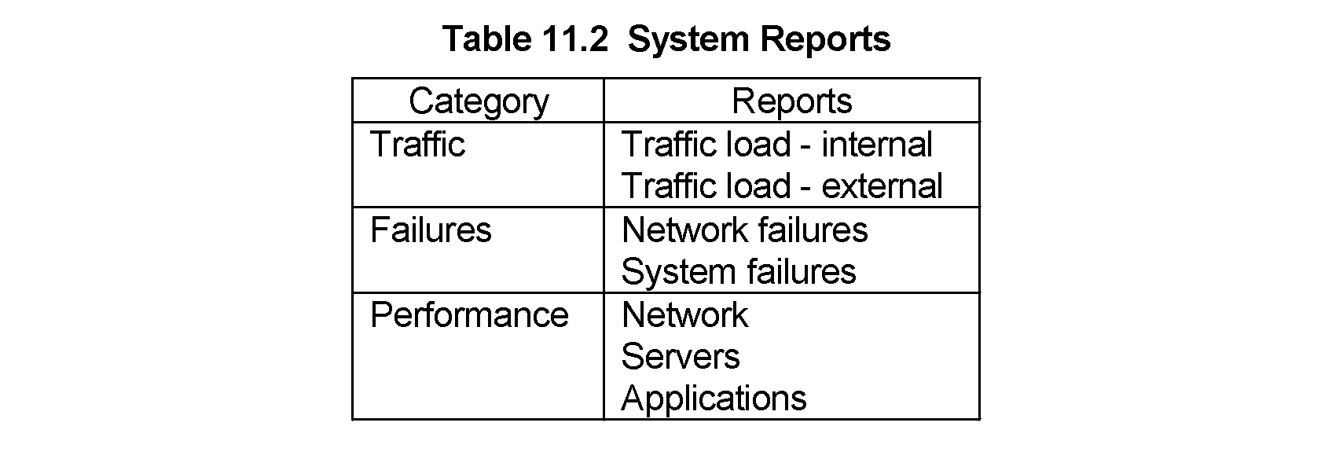
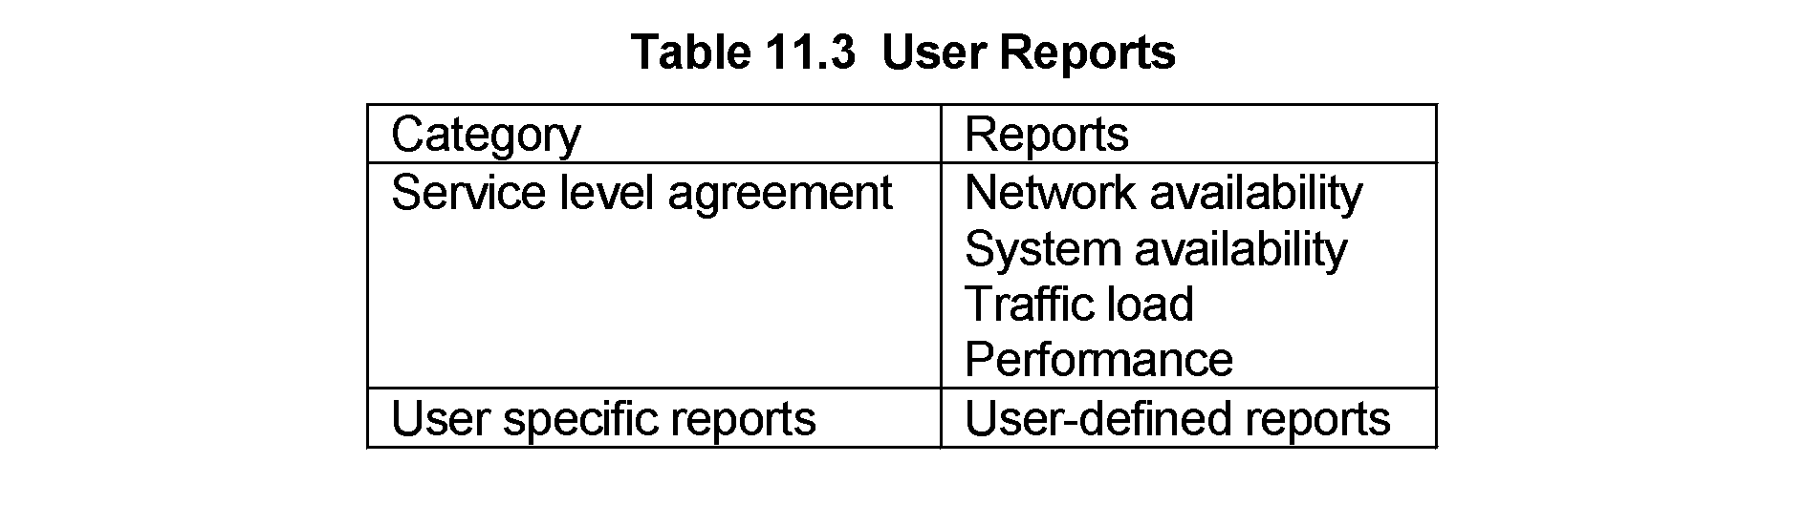
Chapter 11 Network Management Applications
Report Management
It is important to generate, analyze, and distribute various reports to the appropriate groups, even when the network is running smoothly.
We can classify such reports into three categories:
  (1) planning and management reports,
  (2) system reports, and
  (3) user reports.

Slide 69
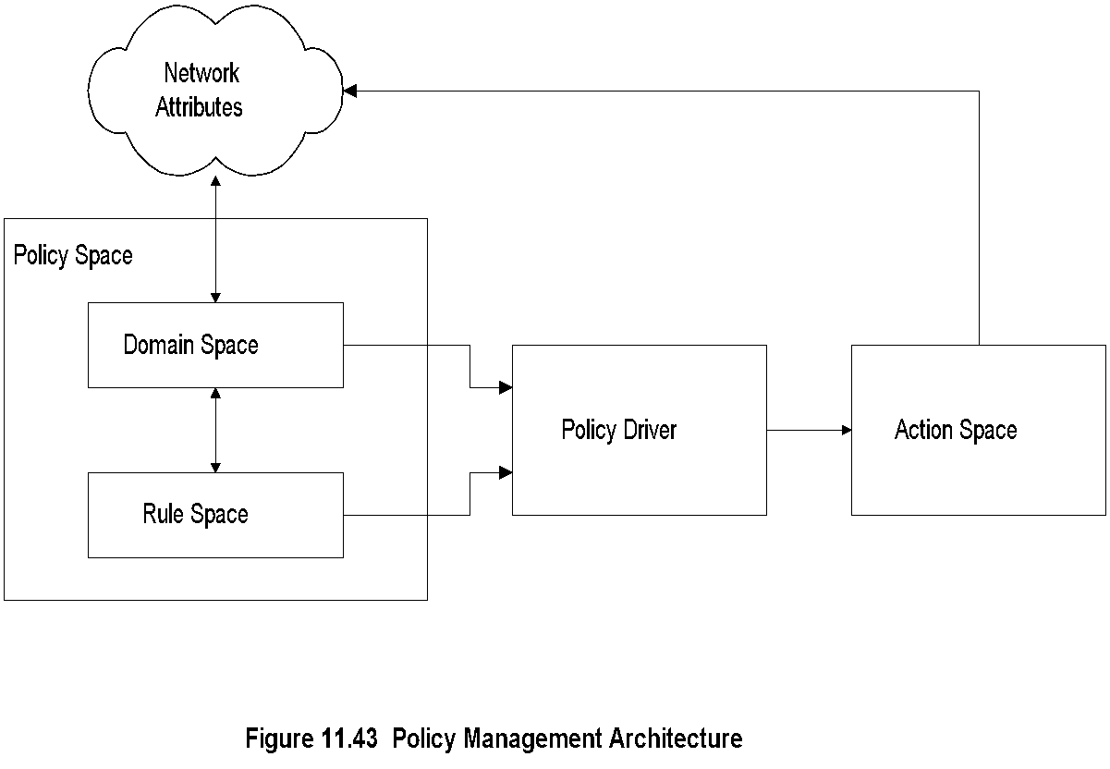
Chapter 11 Network Management Applications
Policy-Based Management
we need to define a policy and preferably build that into the system
  Notes
Domain space consists of objects (alarms with attributes)
Rule space consists of rules (if-then)
Policy Driver controls action to be taken
Distinction between policy and rule; policy assigns responsibility and accountability
Action Space implements actions

Slide 70
Chapter 11 Network Management Applications
Service Level Management
SLA management of service equivalent to QoS of network
SLA defines
  Identification of services and characteristics
  Negotiation of SLA
  Deployment of agents to monitor and control
  Generation of reports
SLA characteristics
  Service parameters
  Service levels
  Component parameters
  Component-to-service mappings
  Notes
policy management should be driven by service level management, which is the second to the top layer in the TMN model
Service level management is defined as the process of(1) identifying services and characteristics associated with them, (2) negotiating an SLA, (3) deploying agents to monitor and control the performance of network, systems, and application components, and (4) producing service level reports
The characteristics associated with services are service parameters, service levels, component parameters, and component-to-service mappings. A service parameter is an index into the performance of a service
The objective of service level management is to ensure customer satisfaction by meeting or exceeding the commitments made in the SLA and to guide policy management. In addition, it provides input to the business management system.

